Slide 1
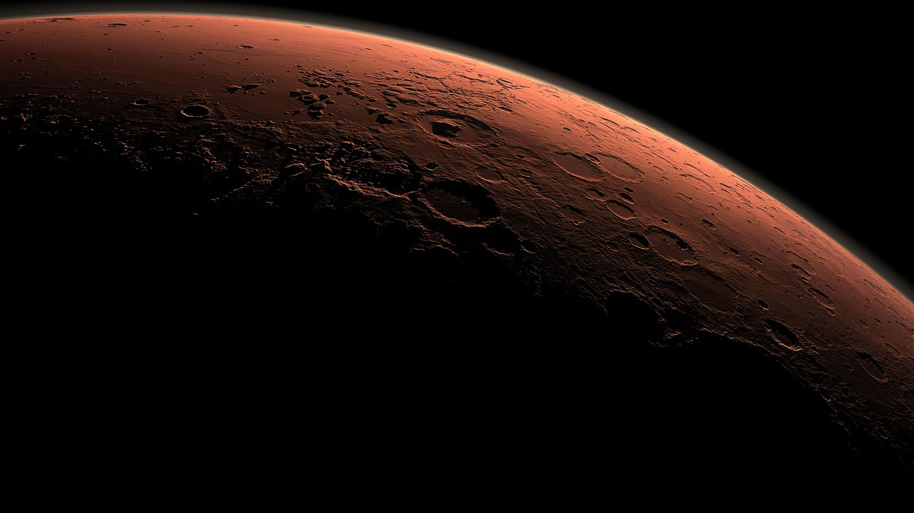


A
T
R
A
E
u
s
S
Prototype Solar Support Rover
Senior Design Summer 2025
By: Mark Figueroa & Pedro Cabrera

Slide 2


Meet the Team
Pedro J. Cabrera
B.S. in Electrical and Computer Engineering Technology Student
- Computer (Fall 2025)
Currently working as a BECET Program TA.
Industrial Cybersecurity Intern at Siemens Energy.
Mark A. Figueroa
B.S. in Electrical and Computer Engineering Technology Student
- Electrical (Spring 2026)
Currently working as a BECET Program TA & serving as the Student Chair of the IEEE Student branch at Valencia.

Slide 3
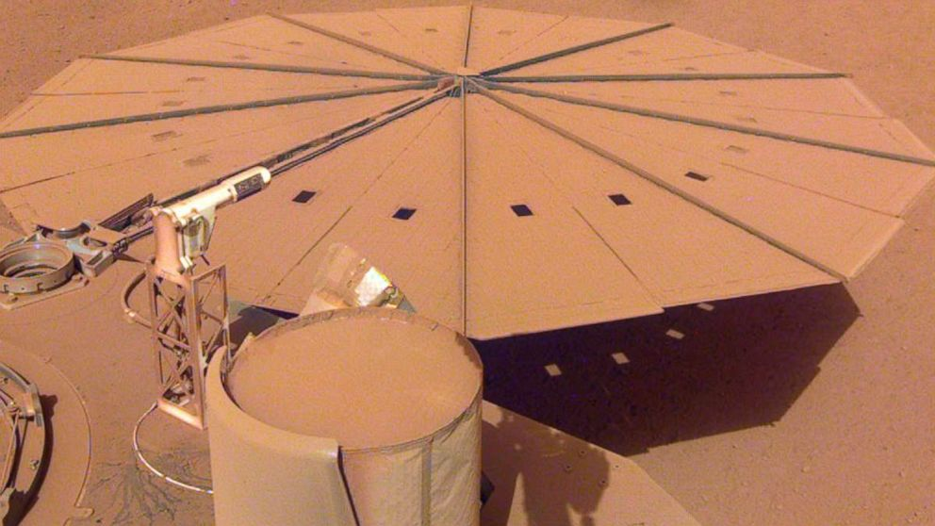
Motivation
Supporting power generation on Mars as plans shift towards human exploration.
Increase Solar panel efficiency hindered by dust accumulation, which directly impacts mission success.
Reduces dependency on astronauts for manual cleaning.
Ensures long-term solar farm functionality for future Martian habitats.
Figure 1- Mars lander losing power due to dust collection on solar panels.

Slide 4
Table of Contents
Section | Title | Slide | Section | Title | Slide
1. | Motivation | 3 | 9. | Contributions | 21-40
2. | Project Overview | 5 | 10. | Testing & Results | 41-45
3. | Limitations | 6 | 11. | Monetary Budget | 46
4. | Similar Products | 7 | 12. | Timeline | 47-48
5. | Engineering Requirements | 8-12 | 13. | Health & Safety | 49
6. | Project Hardware | 13-18 | 14. | Future Improvements | 50
7. | Block Diagram | 19 | 15. | Summary & Conclusion | 51
8. | Power Budget | 20 | 16. | References | 52-55
Notes:
Finish Slide Numbers

Slide 5

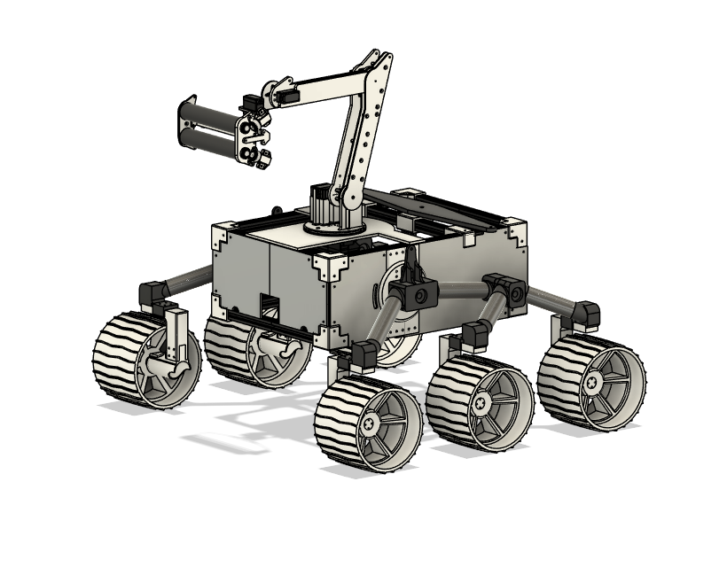
Project Overview
Martian Rover designed for Solar Panel cleaning.
Autonomous Navigation & Obstacle Avoidance so there is no need for user control.
The rover navigates towards to solar panel, Aligns to clean the panel and log the cleaning before returning to initial position.
Dimensions: 31.72” x 28.46” x 27.15”
27.15”
31.72”
28.46”

Slide 6
Limitations
Limitations
Astraeus was built as a scaled prototype to demonstrate subsystem integration, not full mechanical durability or redundancy for Martian use.
Astraeus will use basic sensors and components instead of advanced space-grade instruments.
Instead of full AI-based autonomous navigation, Astraeus will implement basic obstacle avoidance/waypoint-following system.
Testing was limited to panels mounted at 45°.
Astraeus is designed for short-duration testing, rather than extended space missions.
Astraeus cannot connect to NASA's deep space network, so Wi-Fi will be used for data logging.
Due to budget, full regolith testing at UCF’s Mars pit was not performed. Only surface testing and brush trials on MGS-1 were completed.

Slide 7
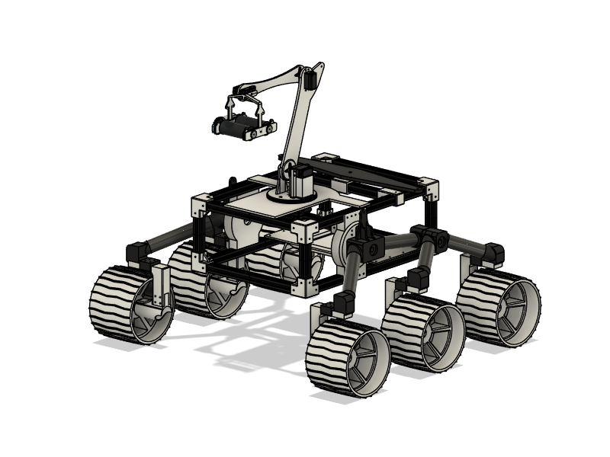
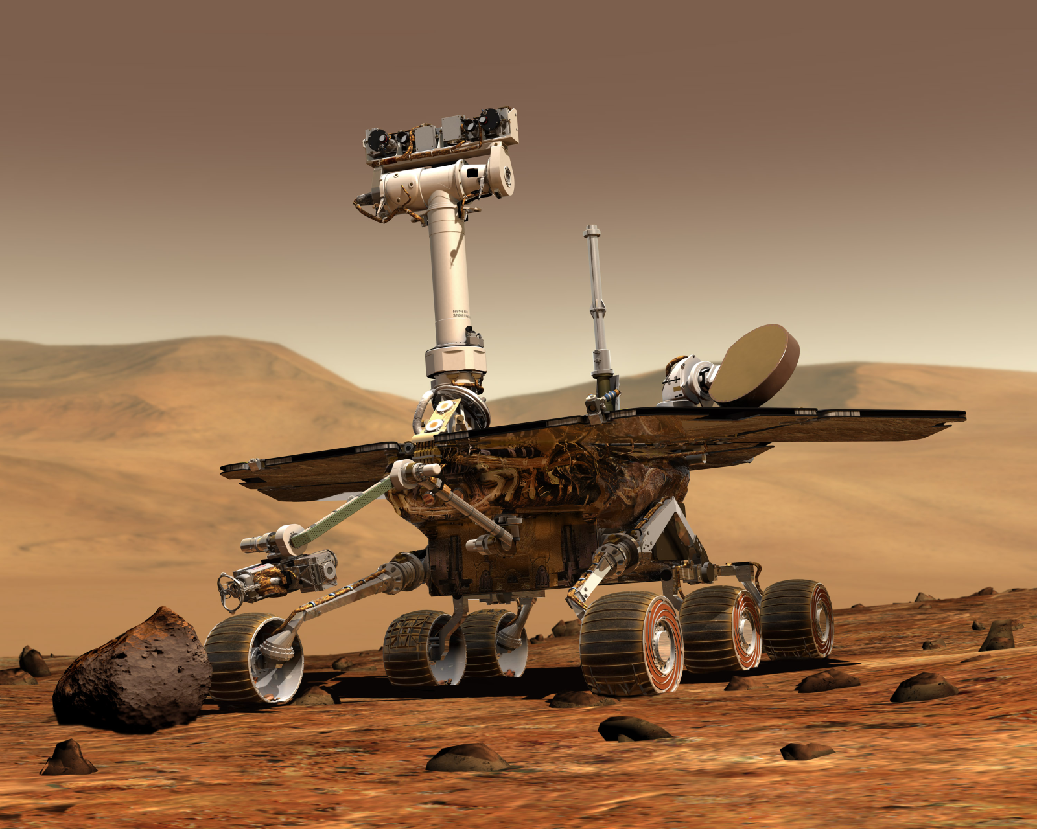
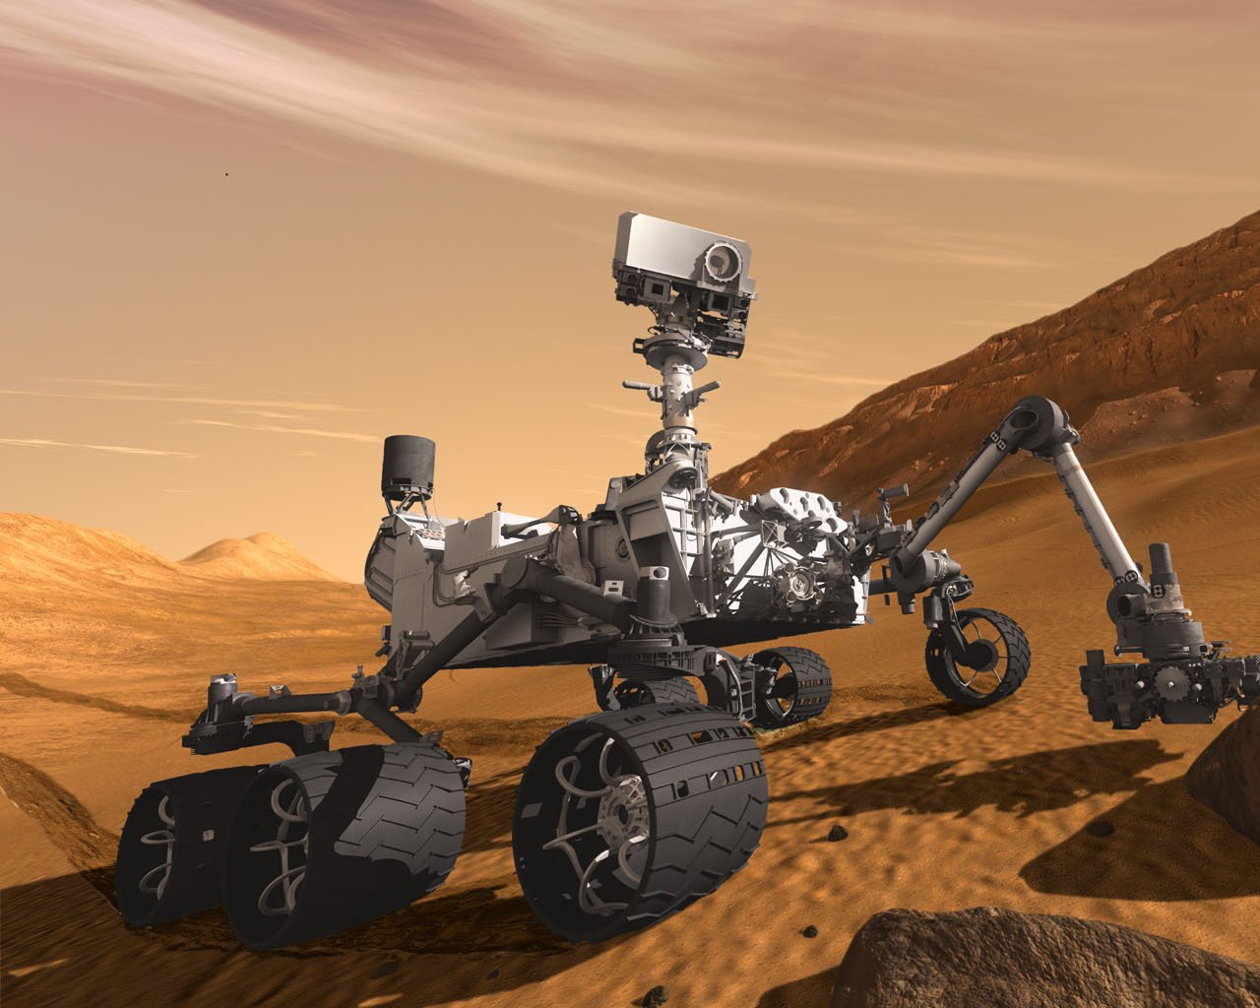
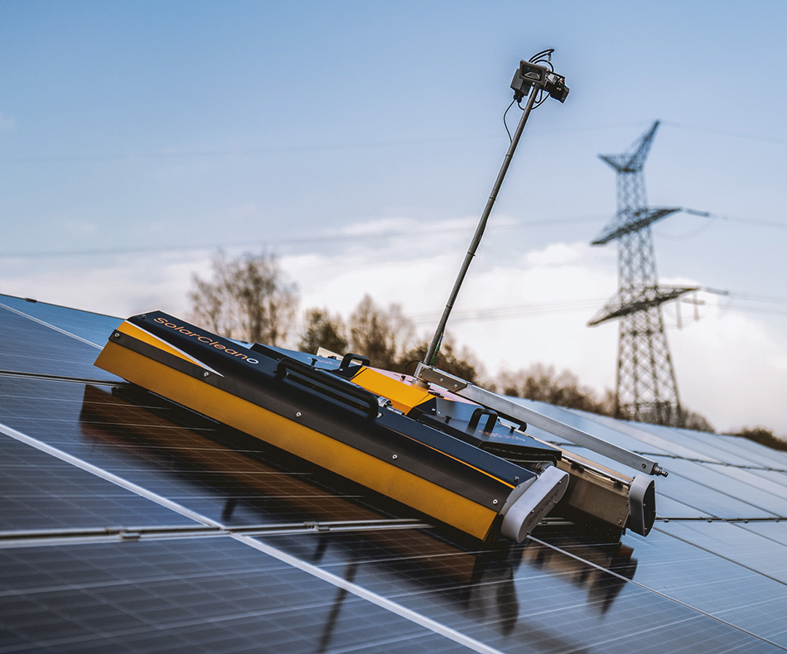
Similar Products
Astraeus
System | Power Source | Mobility | Ability to Clean Solar Panels | Drive System
Astraeus | 12V 30Ah Lithium-ion battery | Rocker-bogie suspension with obstacle avoidance | Dual rotating brush arm with static charge assist | 6 × 12V DC geared motors (skid steering)
Opportunity (MER-B) | Triple-junction solar panels (~140W init.) | Rocker-bogie suspension, autonomous navigation | None; relied on Martian wind/dust devils | 6 independently driven motors
Curiosity Rover | Radioisotope Thermoelectric Generator (RTG) | Rocker-bogie suspension with enhanced navigation | None; uses nuclear power, no need for panel cleaning | 6-wheel independent drive with steering motors
SolarCleano F1 | Swappable battery pack (3–4 hr runtime) | Modular wheeled chassis, remote/manual control | Microfiber roller brush with adjustable pressure | Electric wheeled drive (human or remote)
Opportunity
Curiosity
SolarCleano F1
7

Slide 8
Robotic Arm (Cleaning system) Engineering Requirements
Level | Requirements (Astraeus Shall...) | Verification
High | Utilize a variable speed cleaning brush with precise control over speed and pressure to effectively clean surfaces. | Demonstrate the brush operating at steady speeds and document the cleaning effectiveness at each speed using controlled amounts of debris on the testing surface.
Medium | Document the cleaning of the solar panel by logging the data for users to analyze the performance of the rover. | The system must log all data in a structured format, accessible for further analysis.

Slide 9
Navigation Engineering Requirements
Level | Requirements (Astraeus Shall...) | Verification
High | Autonomously determine its own path to solar panels while avoiding obstacles. | Conduct navigation test where the rover reaches its destination without collision in test trials.
 | Detect larger obstacles up to 40cm without running into them without human intervention. | Validate obstacle detection by testing against various obstacle sizes and distances.
 | Recognize visual cues such as AprilTags, distinct shapes, or colored markers to identify target zones. | Position various April Tag markers for the dedicated panel site and base position. Run various tests where Astraeus must correctly identify and navigate towards each unique marker using its on board vision system.
Medium | Return to the starting position without any human intervention. | Conduct various tests, verify Astraeus successfully navigates back to its start point after completing its cleaning task with no manual correction.

Slide 10
5-Axis Cleaning Arm Engineering Specifications
Module | Component | Engineering Specifications | Justification
Electro-Mechanical Module | Servo | - Torque: 25 kg - Voltage Range: 4.8V– 7.4V - Stall Current: ~3.5 A | - Strong enough for base rotation. - Uses PMW control. - IP67 rated.
 | Servo | - Torque: 45 kg - Voltage Range: 6.0 V – 8.4 V - Stall Current: ~3.5 A | - Strong enough for shoulder rotation. - Uses PMW control. - IP67 rated.
 | Servo | - Torque: 45 kg - Voltage Range: 6.0 V – 8.4 V - Stall Current: ~3.5 A | - Strong enough for elbow rotation. - Uses PMW control. - IP67 rated.
 | Servo | - Torque: 25 kg - Voltage Range: 4.8V– 7.4V - Stall Current: ~3.5 A | - Strong enough for wrist tilt. - Uses PMW control. - IP67 rated.
 | Servo | - Torque: 55g - Voltage Range: 4.8V – 7.4V - Stall Current: ~3.5 A | - Strong enough for wrist rotation. - Uses PMW control. - IP67 rated.
 | Micro-Metal Gear Motor | - Gear Ratio: 75:1 - Voltage Range: 3V – 9V - Stall Current: ~1.6 A | - Provide sufficent torque to rotate cleaning brush through dust/debris. - Compact size to fit within brush housing. - Low power draw suitable for shared power system.
Control Module | Servo Controller | - 6 servo channels (12-bit resolution) - Logic voltage: 5V - Control via USB, UART (TTL) | - Enables precise control of up to 6 servos. - USB and UART options allow easy integration with microcontrollers or PC. - Built-in scripting for autonomous sequences without a host controller.
 | Motor Drivers | - Rated for 12V motor operation. - Supports bidirectional speed control for 6 motors. | - Enables independent control of the duel rotating brush

Slide 11
Drive System Engineering Specifications
Module | Component | Engineering Specifications | Justification
Electro-Mechanical Module | Motors (x6) | - 12V DC - Peak Current: 15 A - Gearbox Output: ~100 RPM | - High torque output to support rover mobility and terrain traversal. - Geared motors reduce speed for increased torque.
Control Module | Motor Drivers | - Rated for 12V motor operation. - Supports bidirectional speed control for 6 motors. | - Enables independent control of left/right motor groups. - Required to safely and efficiently drive multiple motors under load.
 | Microcontroller | - Minimum 12 PWM-capable pins - Supports UART, I²C for peripherals | - Required for precise motor control and servo actuation. - Must support communication with sensors and AI camera.
 | IR Analog Distance Sensor | - Voltage: 5V - Current Draw: ~30 mA - Range: up to 31 cm | - Used for edge detection and alignment with solar panel. - Enables basic obstacle avoidance and correction.
 | AI camera | - Supports onboard object tracking via AI - Compatible UART/I²C | - Captures and analyzes solar panel position for autonomous alignment. - Enables visual feedback loop for positioning system.

Slide 12
Power Module Engineering Specifications
Module | Component | Engineering Specifications | Justification
Power Module | Drive System Battery | 12V 30Ah | - Provides sufficient current and capacity to operate the full drive system for at least 1 hour.
 | Voltage regulator (Step Down) | 12V to 7V regulator | - Powers subsystems requiring 6V.
 | Voltage regulator (Step Down) | 12v to 5V regulator | - Powers 5V logic devices like sensors, camera modules, and microcontroller.

Slide 13
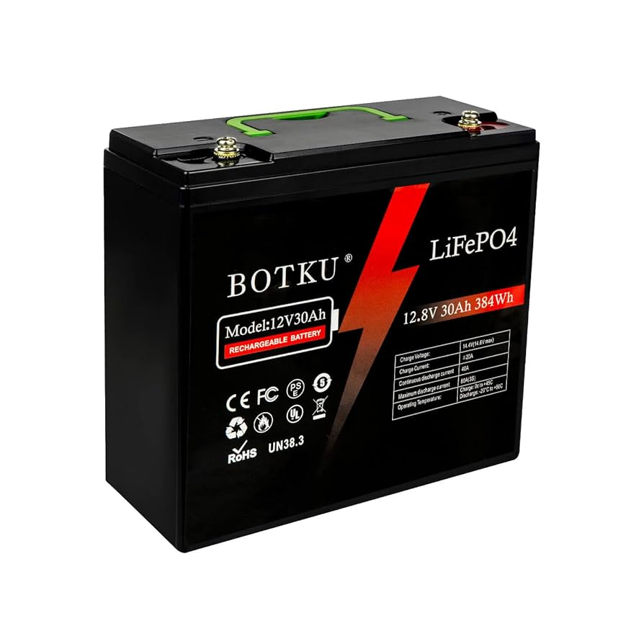
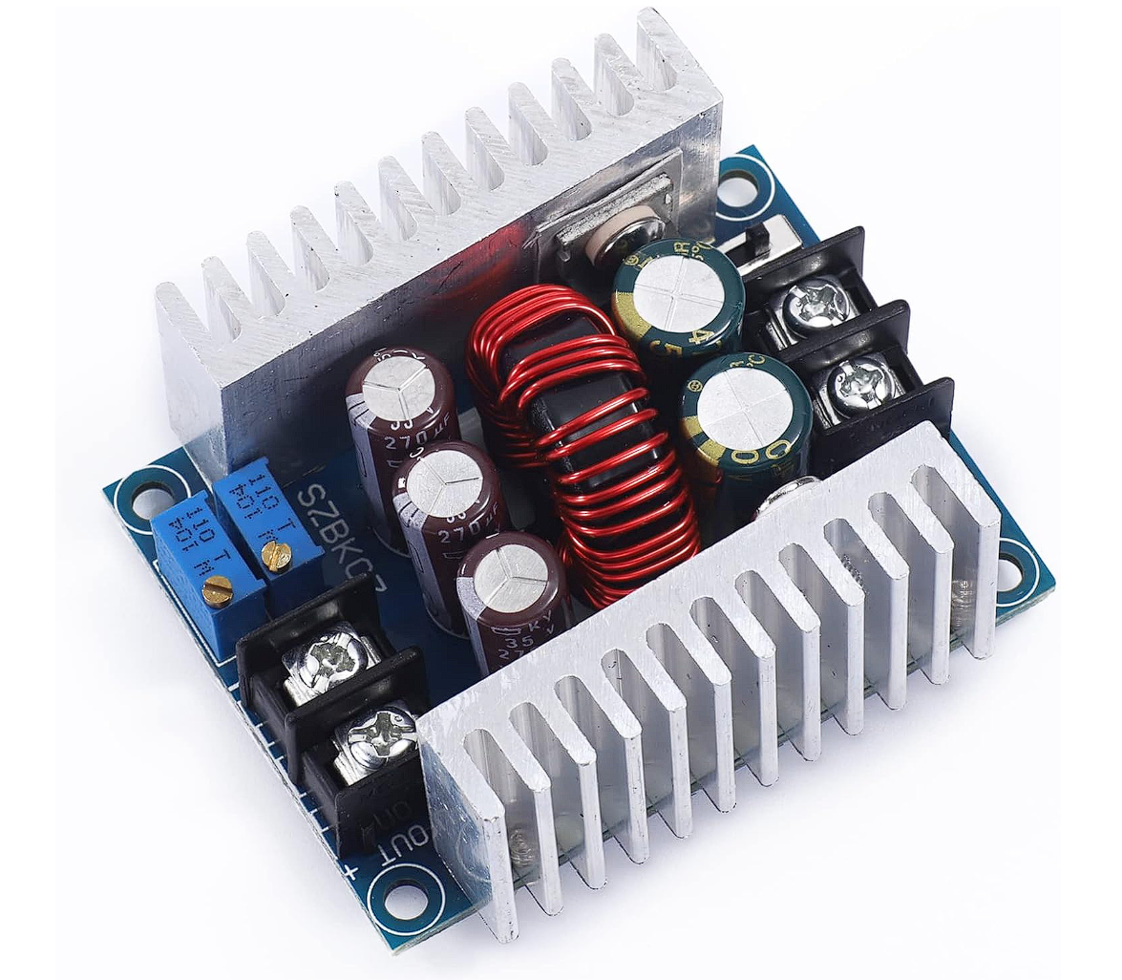
Project Hardware
Power Module
12V Battery:
Primary power source for all onboard systems, providing stable energy for extended field operations.
Buck Converters:
Step down the 12V input to regulated 7V and 5V outputs for electronics and sensors at 20 Amps peak.

Slide 14
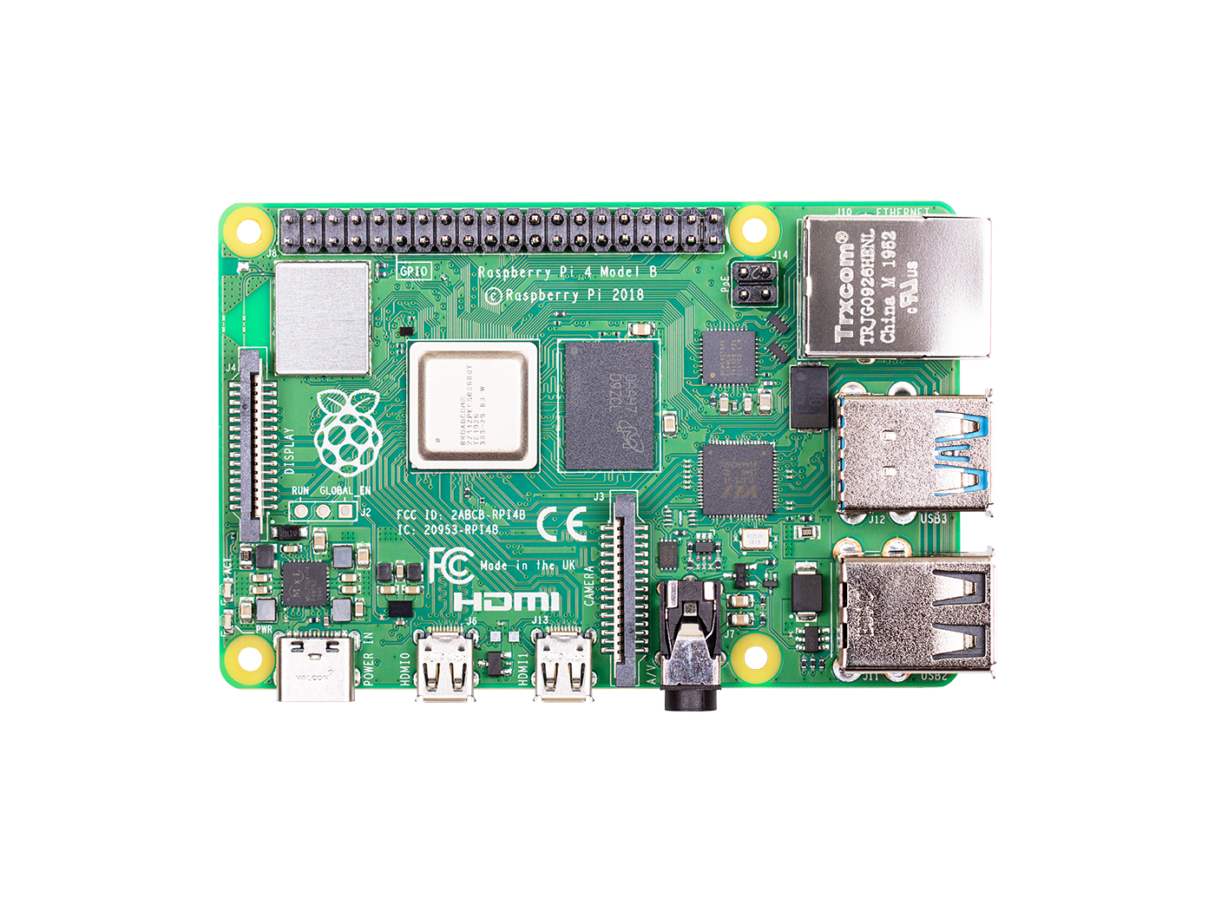
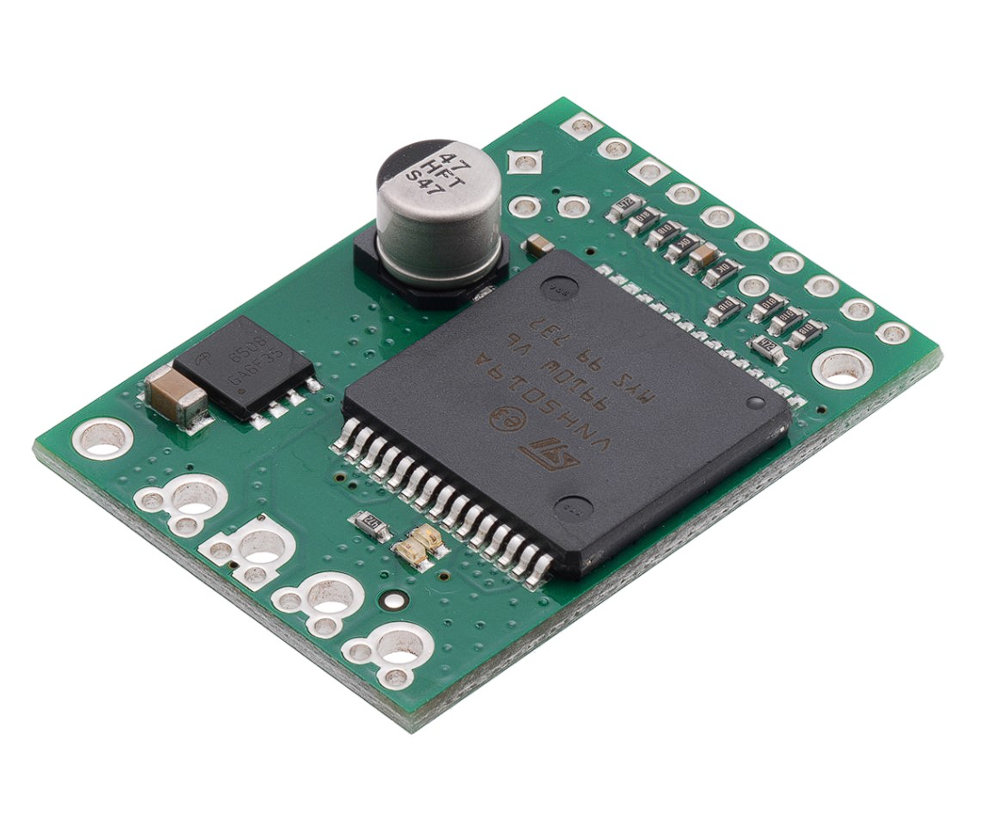
Project Hardware
Control Module
Raspberry Pi 3 Model B:
Serves as the main processing unit, handling vision input, autonomous logic, and web-based user control.
Pololu VNH5019 Dual Motor Driver Carrier:
Delivers high-current motor control for the rover’s skid-steer drive system, ensuring smooth and responsive mobility.

Slide 15
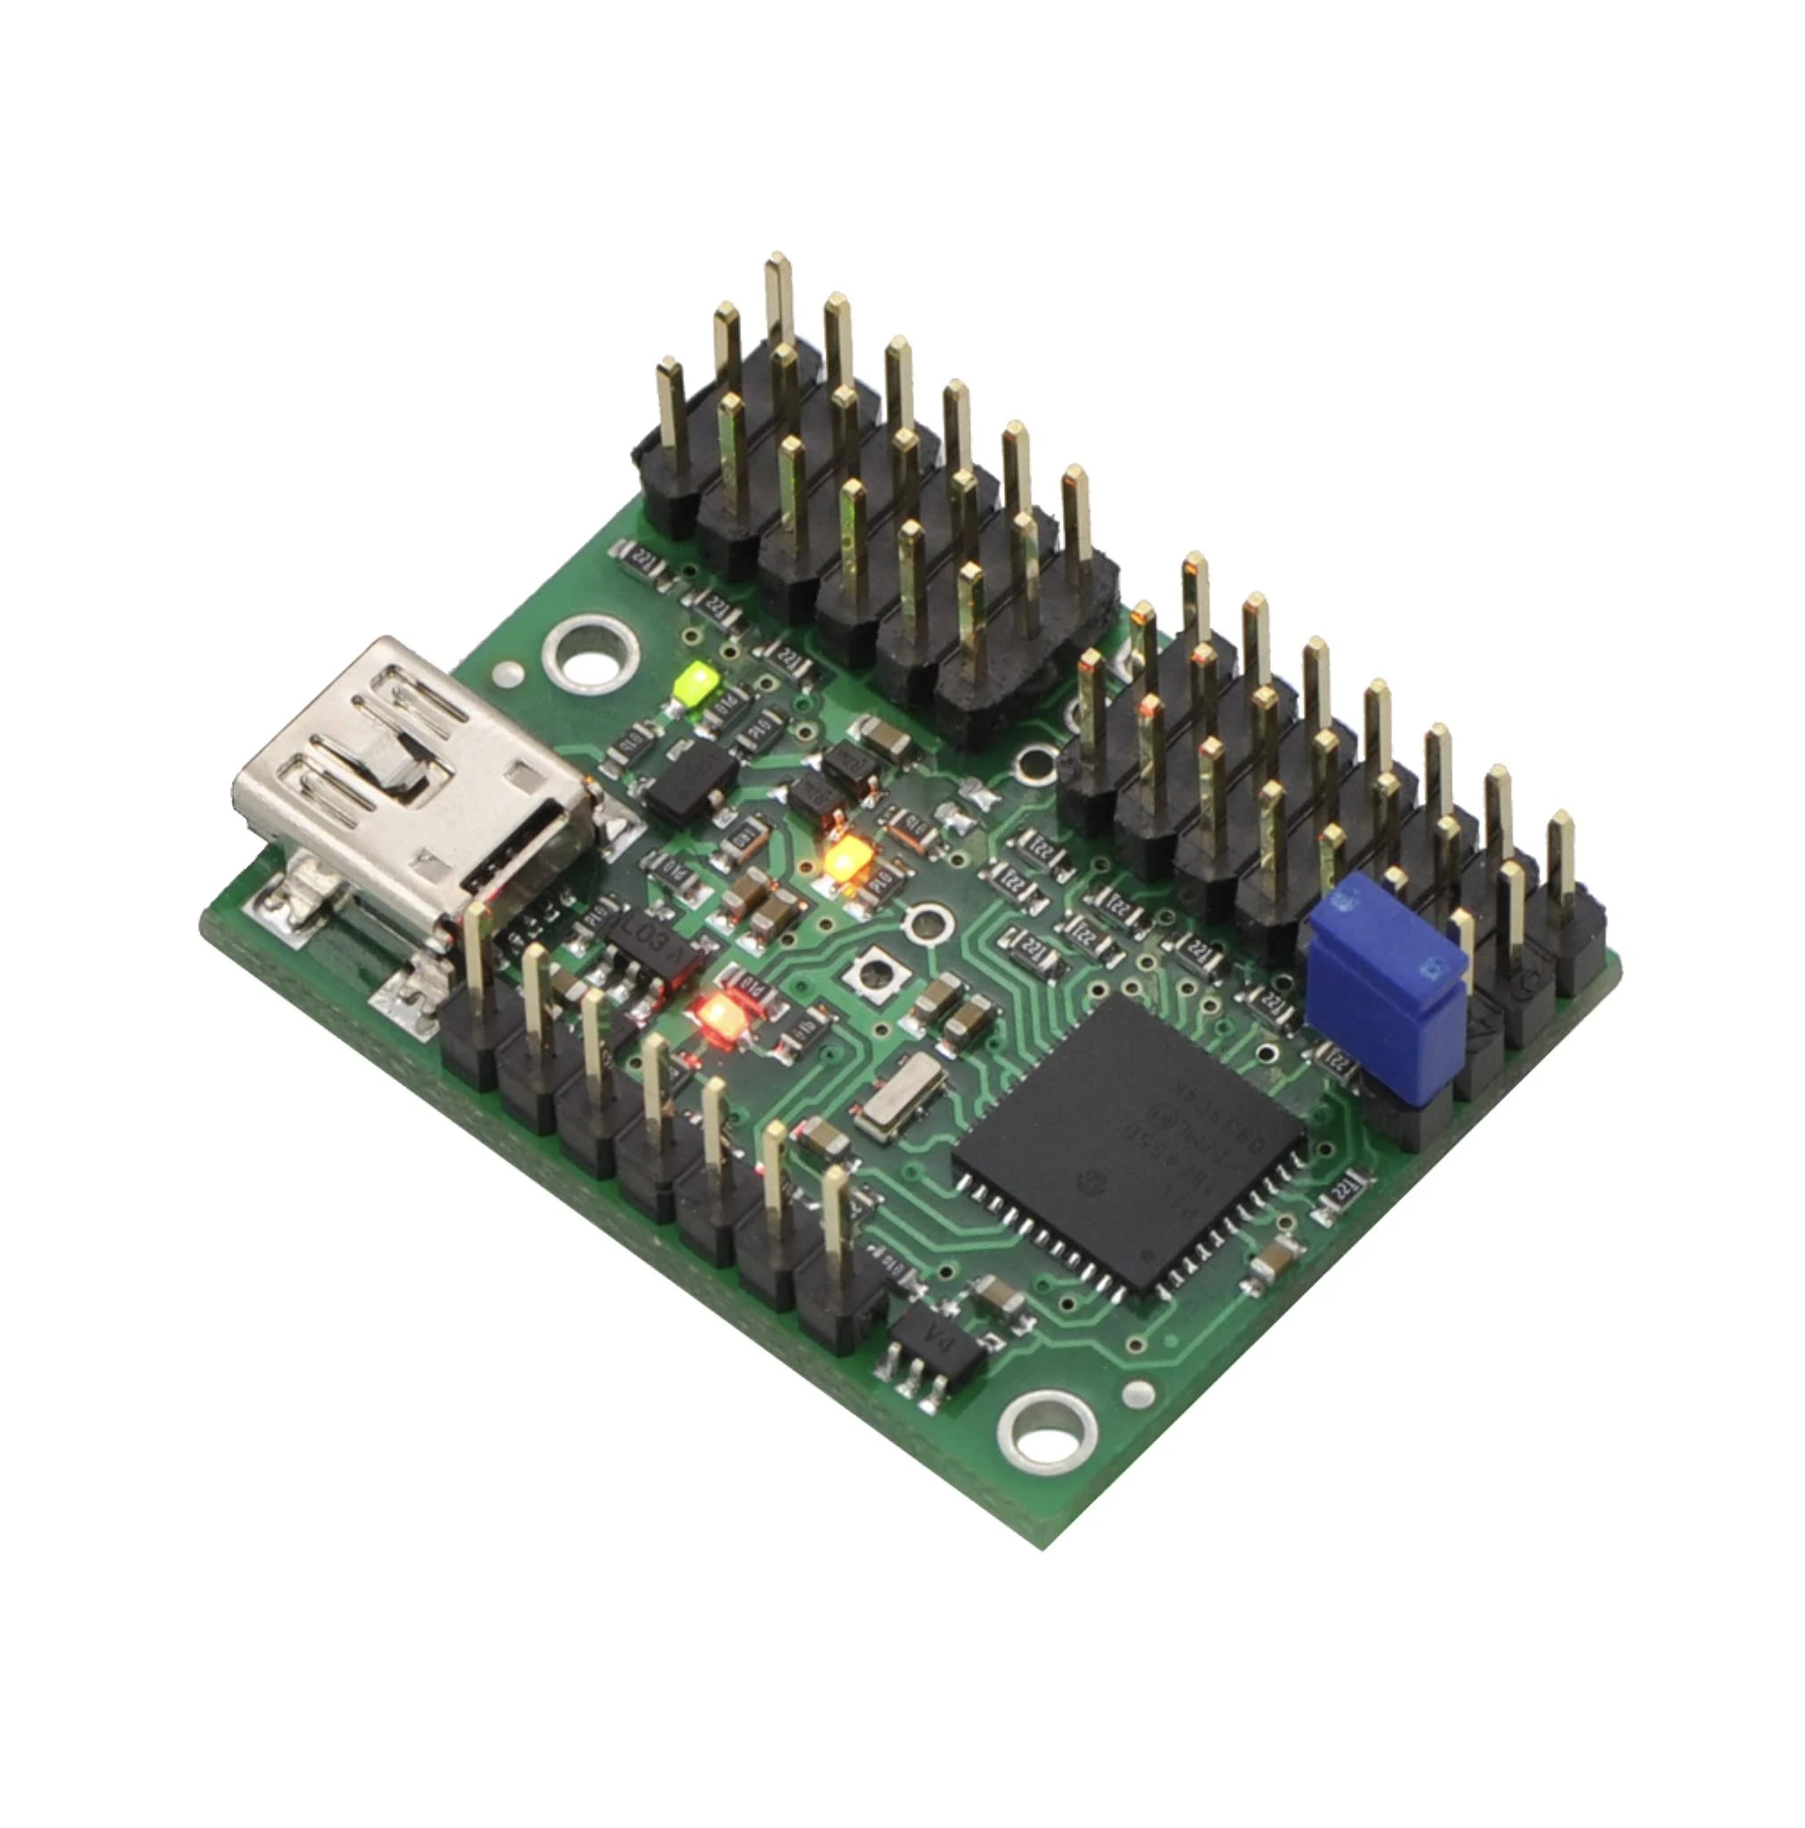
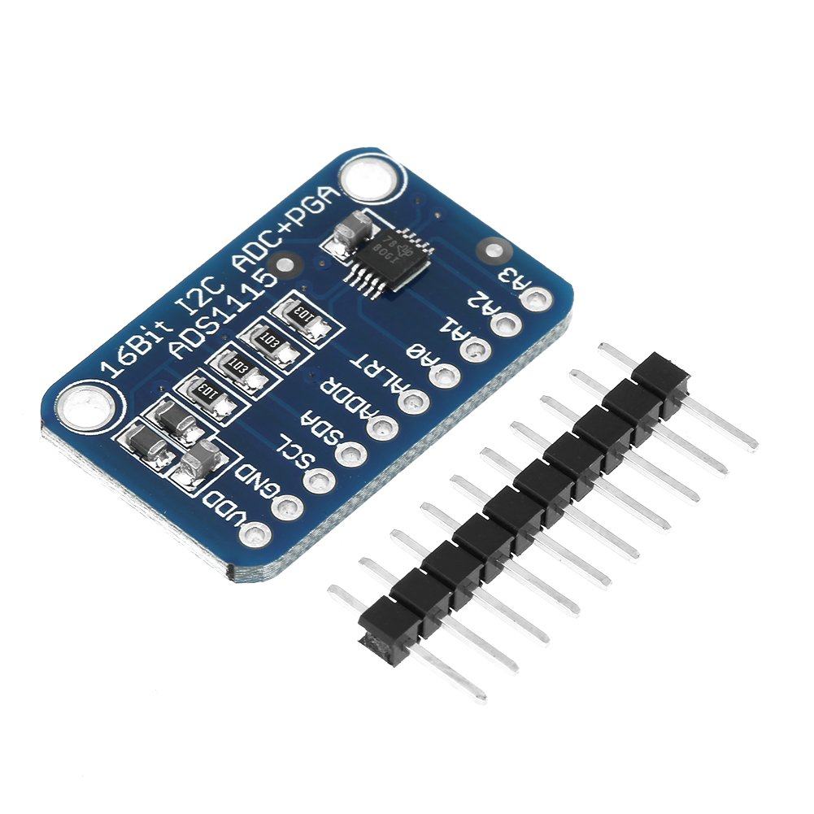
Project Hardware
Control Module
Pololu Mini Maestro 12-Channel USB Servo Controller:
Executes preprogrammed servo sequences for tasks like solar panel cleaning via compact and precise subroutine control.
Adafruit ADS1115 16-Bit ADC (Analog-to-Digital Converter):
Converts analog IR sensor readings into precise digital values for real-time obstacle detection and alignment.

Slide 16
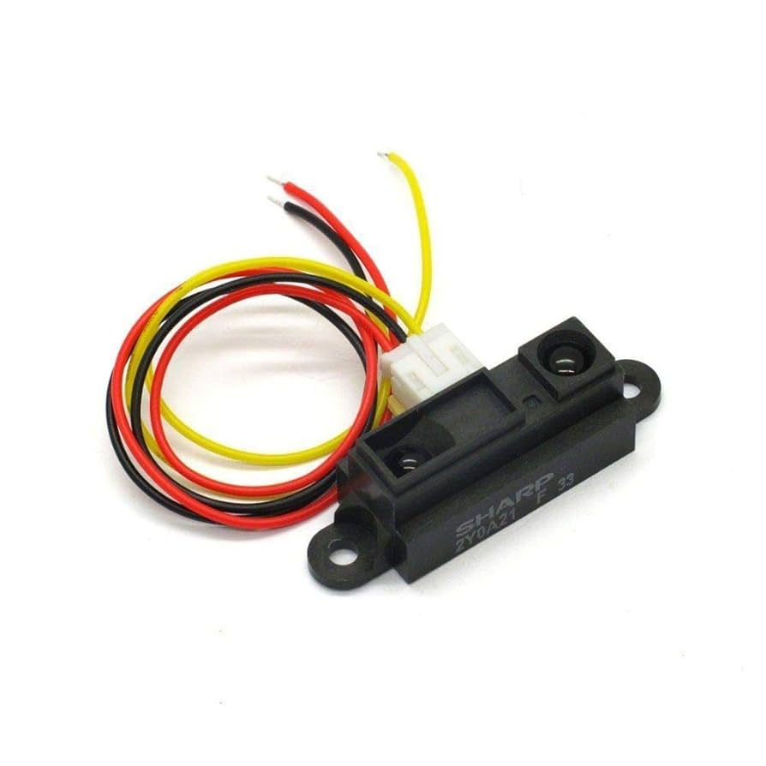
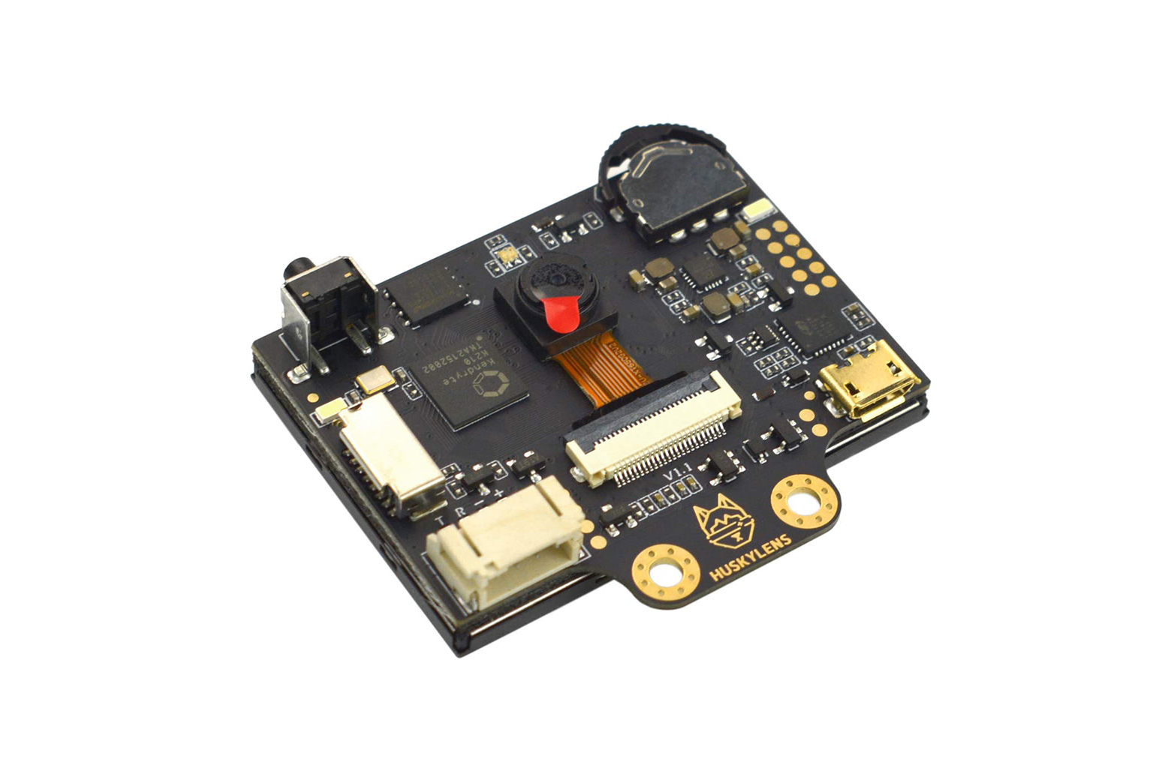
Project Hardware
Vision Module
Sharp GP2Y0A21YK0F Infrared Sensors:
Used for short-range obstacle detection and precise alignment during cleaning operations by measuring distance to nearby objects.
HuskyLens AI Vision Camera:
Provides AprilTag recognition and object tracking, enabling the rover to locate and align with solar panels autonomously.

Slide 17
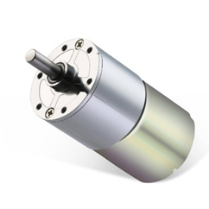
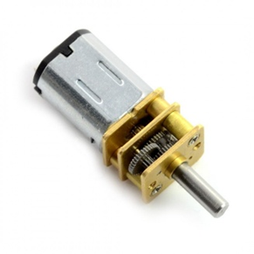
Project Hardware
Electromechanical Module
Geartistan 12V 100RPM Gear Motor:
Provides strong and steady torque for drive or cleaning functions requiring moderate rotational speed.
N20 75:1 12V Micro Gear Motor:
Compact motor used for low-load mechanical movements, offering fine control via high gear reduction.

Slide 18
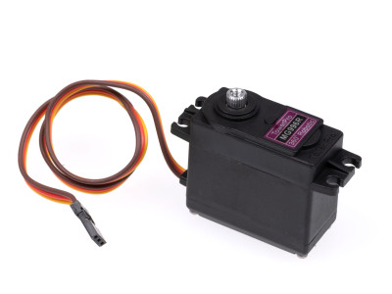
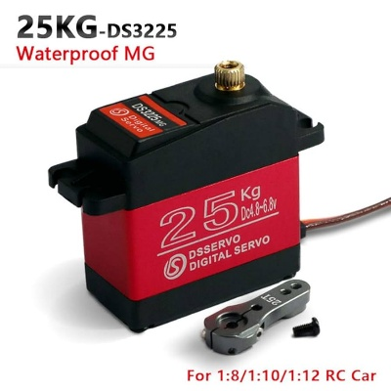
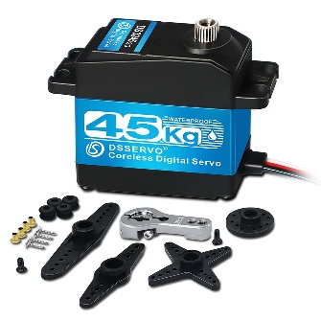
Project Hardware
Electromechanical Module
DS3225 25kg High-Torque Digital Servo:
Used for moderate-load applications such as the Base and wrist up/down.
ANNIMOS 45kg High-Torque Digital Servo:
Provides heavy-duty torque output for shoulder and elbow motion.
55g High-Torque Digital Servo:
Compact and versatile servo used for the wrist left/right.

Slide 19
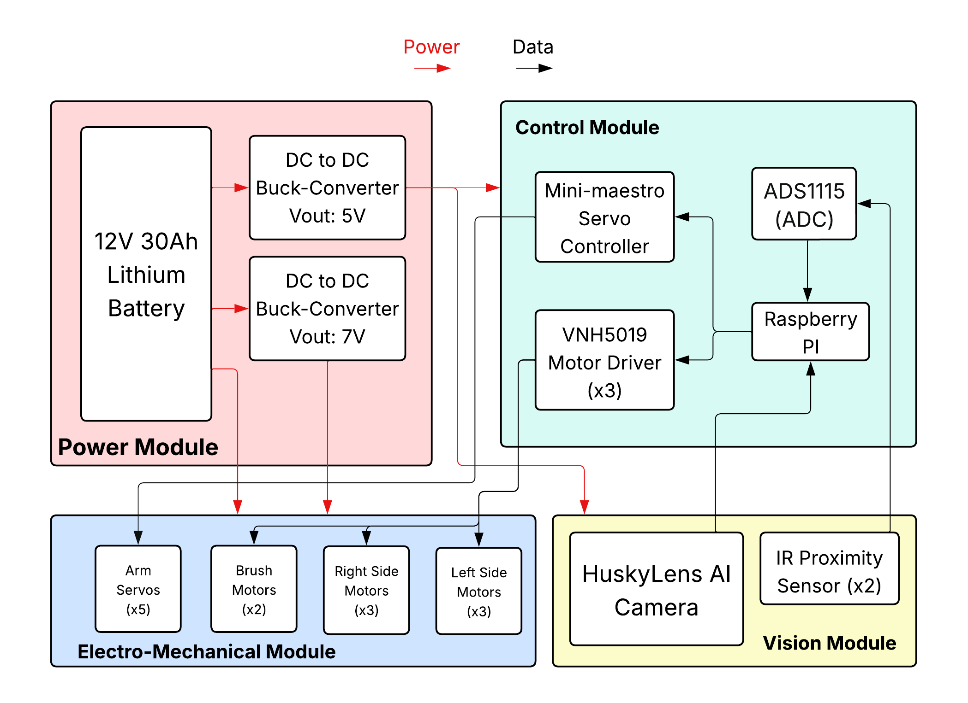
Block Diagram

Slide 20
Control Module Power
Component | Voltage (V) | Current (A) | Power (W) | Qty | Total Power (W)
Raspberry Pi 3 Model B | 5 | 3 | 15 | 1 | 15
VNH5019 Motor Driver Carrier | 12 | 2.4 | 28.8 | 2 | 57.6
VNH5019 Motor Driver (Logic Supply) | 3.3 | 0.04 | 0.132 | 2 | 0.264
VNH5019 Motor Driver Carrier | 7 | 0.04 | 0.28 | 1 | 0.28
VNH5019 Motor Driver (Logic Supply) | 3.3 | 0.04 | 0.132 | 1 | 0.132
Maestro Servo Controller | 6 | 1 | 6 | 1 | 6
ADS1115 16 Bit ADC PGA Converter | 5 | 0.03 | 5.03 | 1 | 5.03
Total (W) |  |  |  |  | 77.63
Electro-Mechanical Module Power
Component | Voltage (V) | Current (A) | Power (W) | Qty | Total Power (W)
Geartisan 12V 100RPM Motors | 12 | 0.8 | 9.6 | 6 | 57.6
25kg Servos | 7 | 2.5 | 17.5 | 2 | 35
45kg Servos | 7 | 4.5 | 31.5 | 1 | 31.5
55g Servos (Wrist & Tilt) | 7 | 0.4 | 2.8 | 1 | 2.8
N20 Micro Gear Motors | 7 | 0.35 | 2.45 | 2 | 4.9
Total (W) |  |  |  |  | 131.8
Vision Module Power
Component | Voltage (V) | Current (A) | Power (W) | Qty | Total Power (W)
HuskyLens AI | 5 | 0.32 | 1.6 | 1 | 1.6
Sharp IR Analog Distance Sensor | 5 | 0.03 | 5.03 | 4 | 20.12
Total (W) |  |  |  |  | 21.72
System Total (W) |  |  |  |  | 231.15
Power Module
Component | Voltage (V) | Current (A) | Power (W) | Qty | Total Power (W)
LiFePO4 Deep Cycle Battery | 12 | 30Ah | 360 Wh | 1 | 360
Total (W) |  |  |  |  | 360
Power Budget

Slide 21
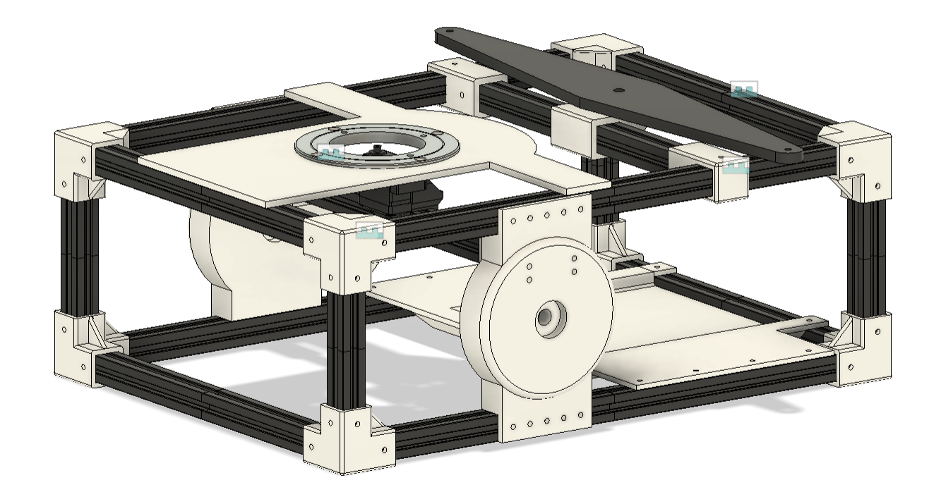
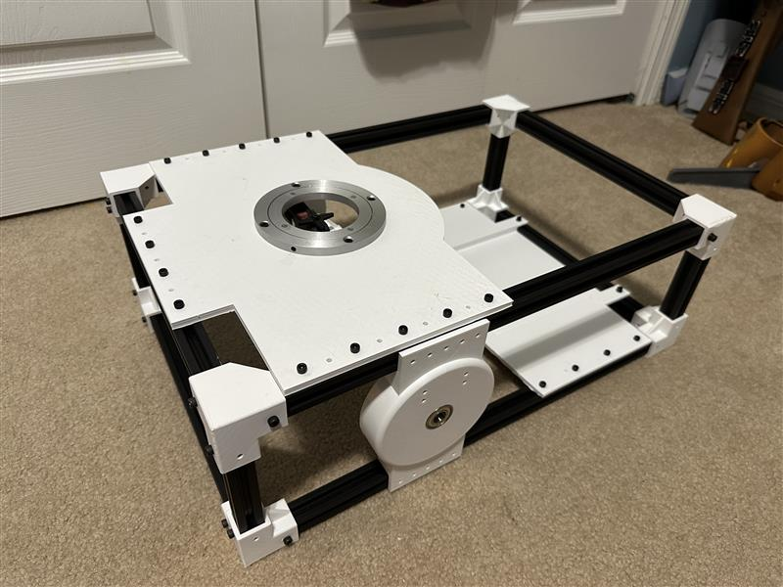
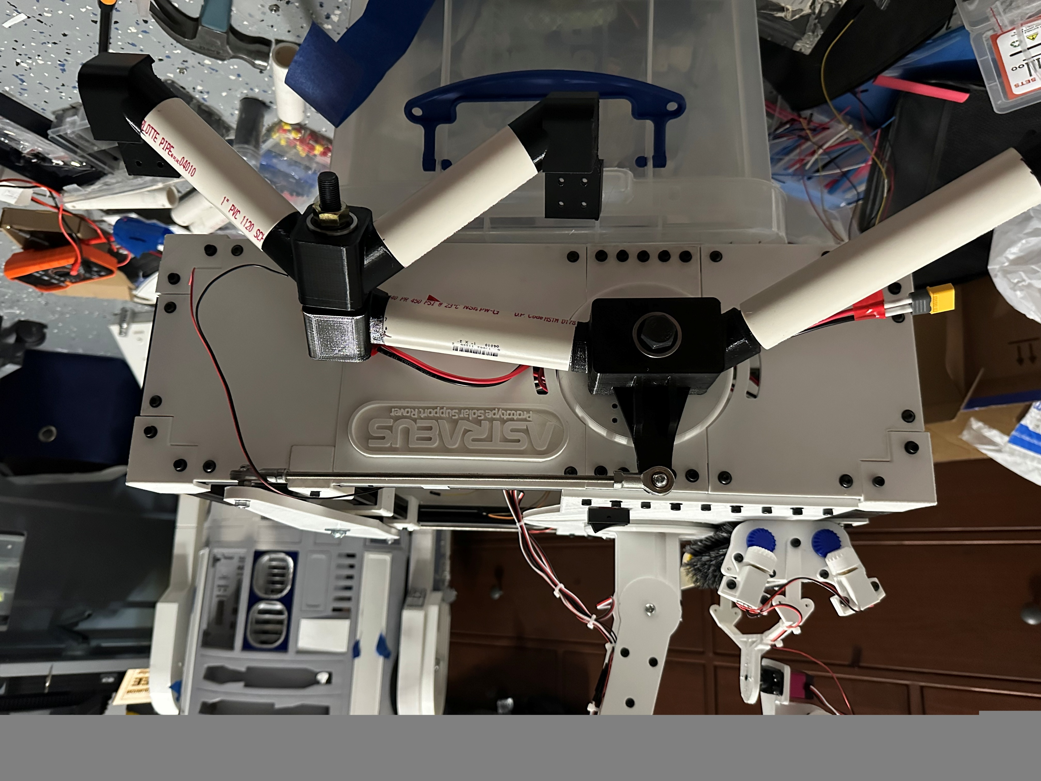
Contribution: Main Chassis CAD
Designed in Autodesk Fusion to use 20×20 mm aluminum extrusion frame.
All components printed in PETG.
integrated rocker-bogie suspension mounts.
Cover panels to protect electronics for dust mitigation.

Slide 22
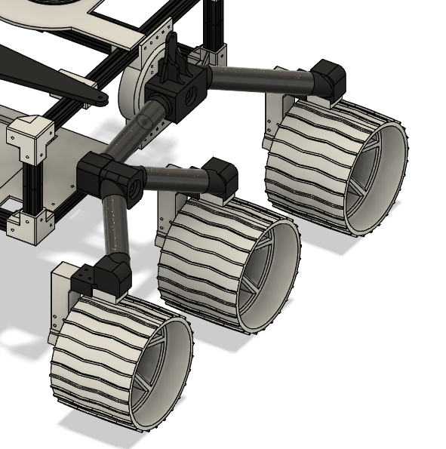
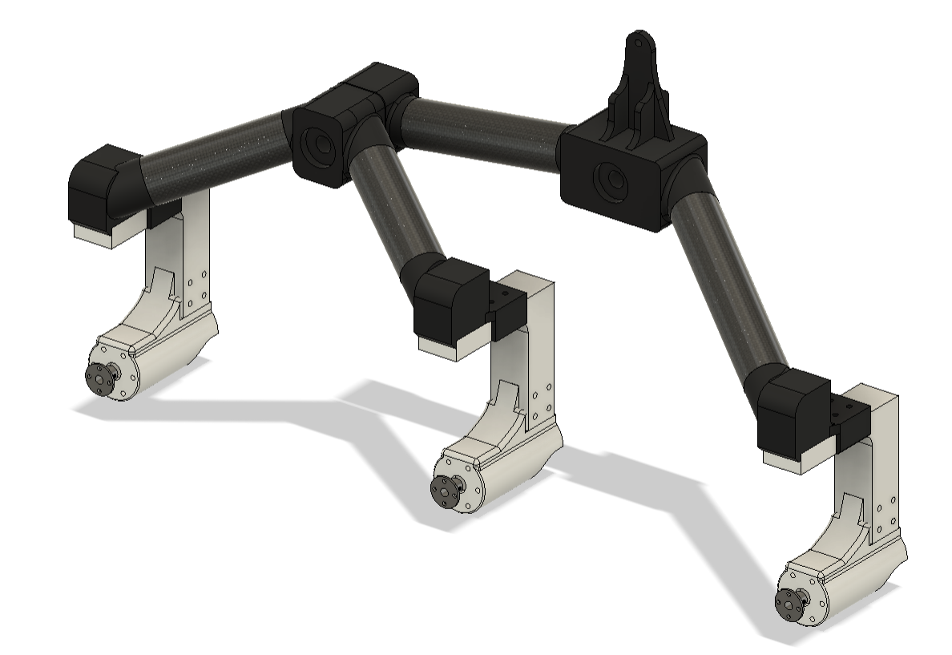
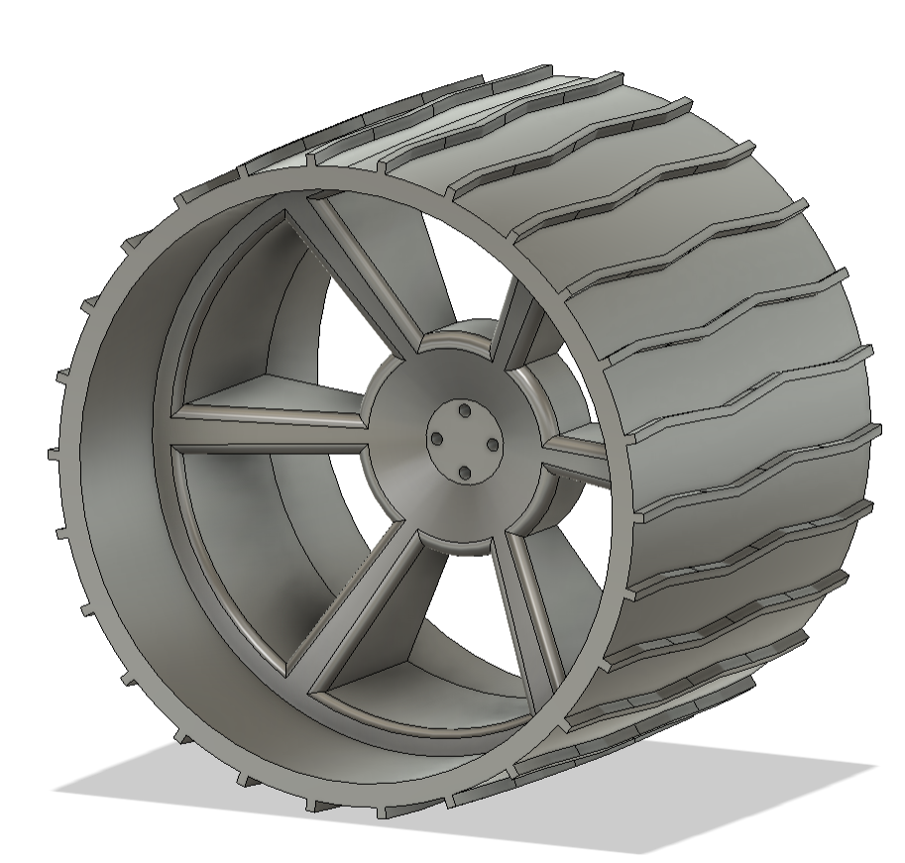
Contribution: Rocker Bogie System
Contribution: Rocker Bogie System
Began by designing and printing the wheel, establishing the foundation for all attachment geometry.
Developed modular suspension arms, axle brackets, and a central pivot hub to ensure easy field replacement.
Modularity was essential, since the suspension is always in contact with the ground, any breakage had to be serviceable without disassembling the full system.
22

Slide 23
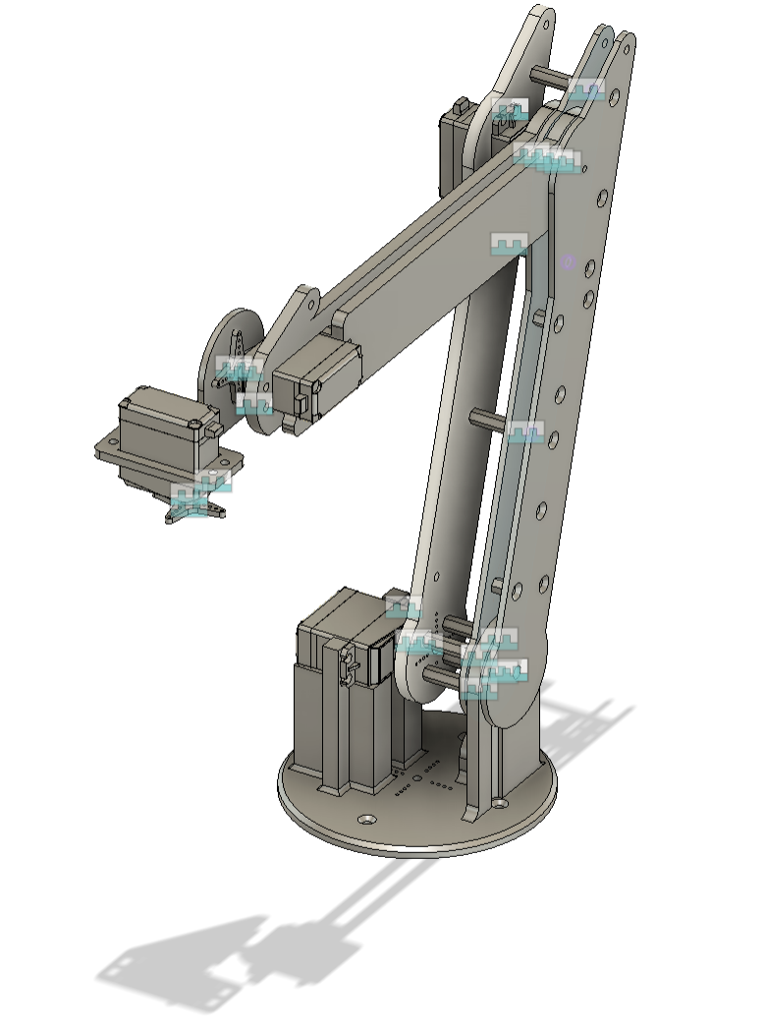
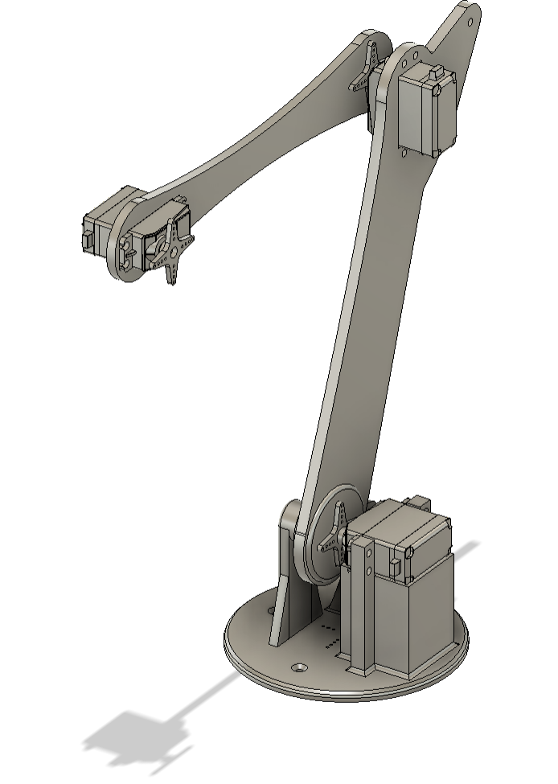
Contribution: 5-Axis CAD
Modeled a custom 5-axis robotic arm in Autodesk Fusion, designed for lightweight PETG
Integrated servo mounting points for base, shoulder, elbow, wrist, and tilt joints
Designed with reinforced brackets and double-shear mounting for increased torque/Stability
Include lazy-Susan bearing integration at the base to reduce rotational load
Optimized arm geometry for a 27.5 in. reach to cover solar panel surface at a 45° tilt
Servos draw 7V / 16.5 Amps peak .
  Routed through 7V / 20 Amps peak power rail.
Proposed Design
Finalized Design

Slide 24
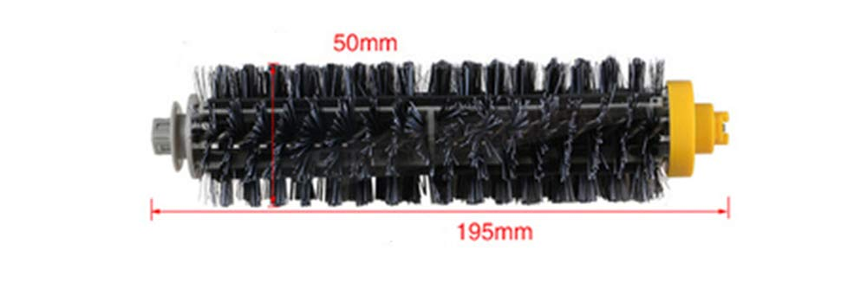
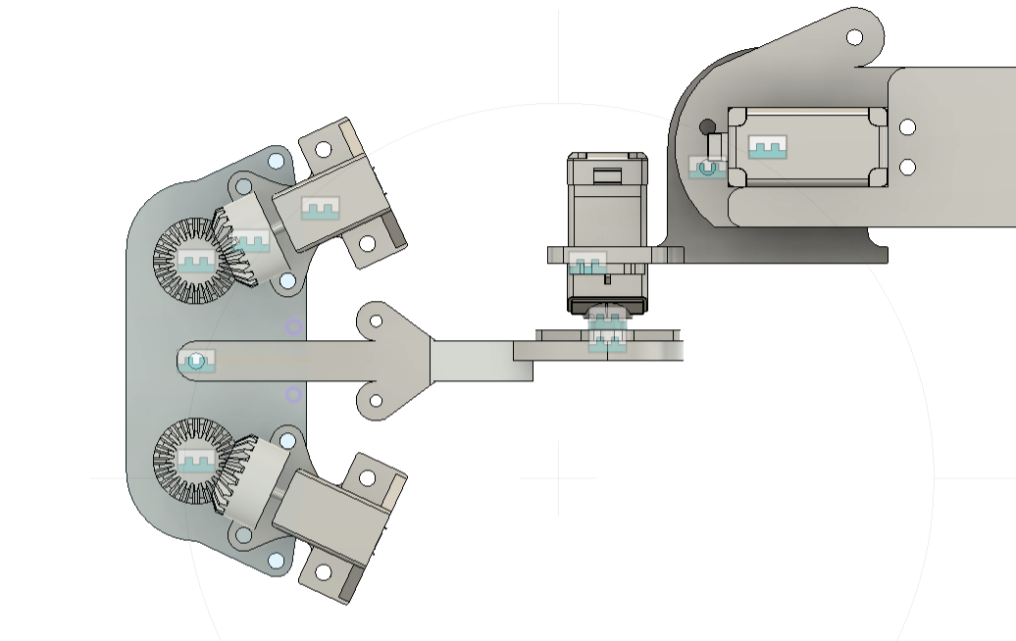
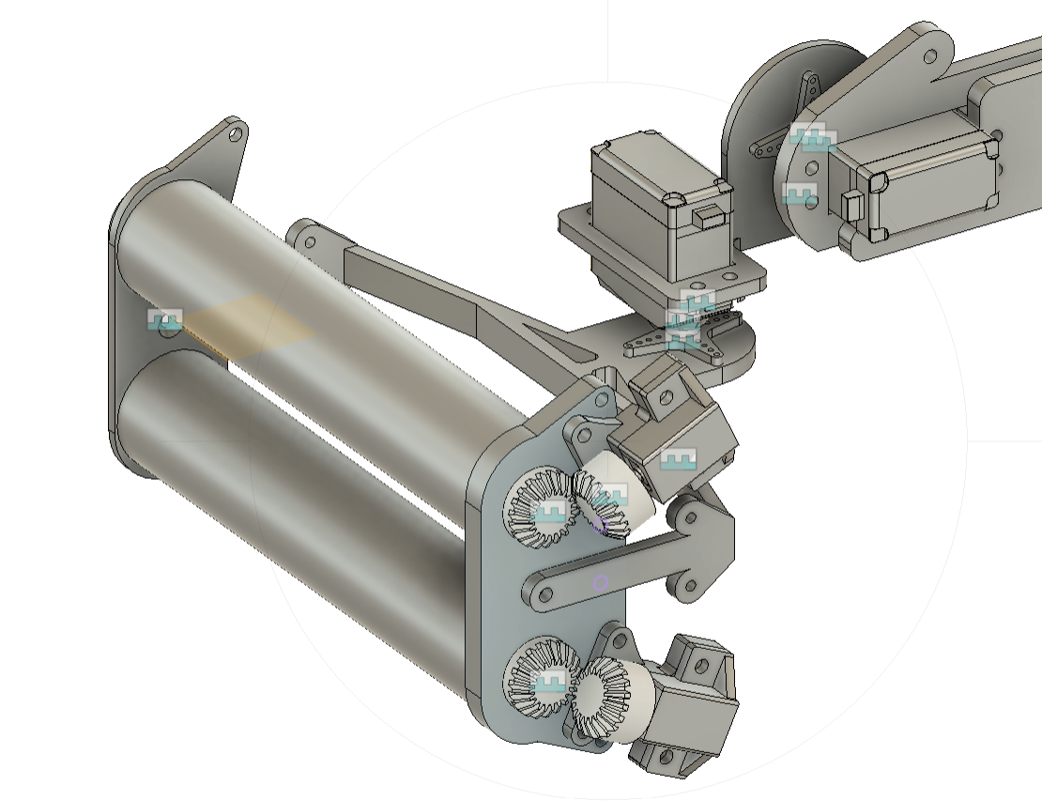
Contribution: Brush CAD
Design a dual rotation brush module utilizing static bristles
(Eco maid Brush Replacement)
Low profile brush housing.
Motor housings for N20 Motors to spin beveled gear drive train.
Integrated onto 5-Axis arm to be able to tilt and pivot.
Routed in Parallel through 7v power rail.

Slide 25
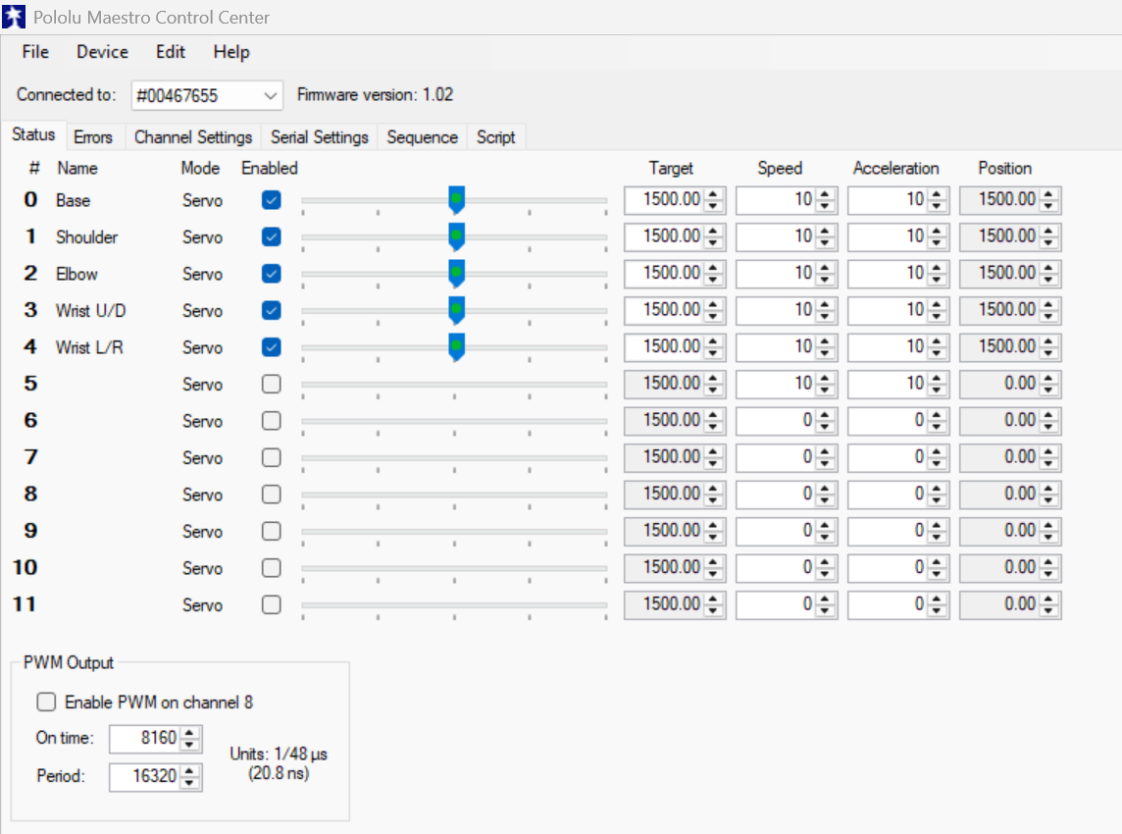
Contribution: 5-Axis Software
Programmed through Pololu Maestro Control Center and saves routines directly to the Maestro Controller.
Utilizes Visual programing to position the arm and modify speed, acceleration, and servo limits.
Developed motion sequences for panel approach, cleaning path, and rest positions.
Routines are called as a sequence from the main rover code without recurring scripts.

Slide 26
Contribution: Software Architecture
The Astraeus system is structured into modular Python scripts, each responsible for a specific task.
Two parallel processes run at startup:
  A Flask web server (app.py) for user interaction and log display.
  The main control loop (main.py) for handling commands.
Manual and autonomous modes are selected through the web interface (mode.html).
Movement commands are processed through motors.py, supporting direction and PWM control.
Autonomous behavior (e.g. tag following, alignment) is encapsulated in autonomy.py.
All logs, alerts, and warnings are stored in a local SQLite database via logger.py.
The maestro_module.py triggers cleaning sequences using the Pololu Maestro controller.

Slide 27
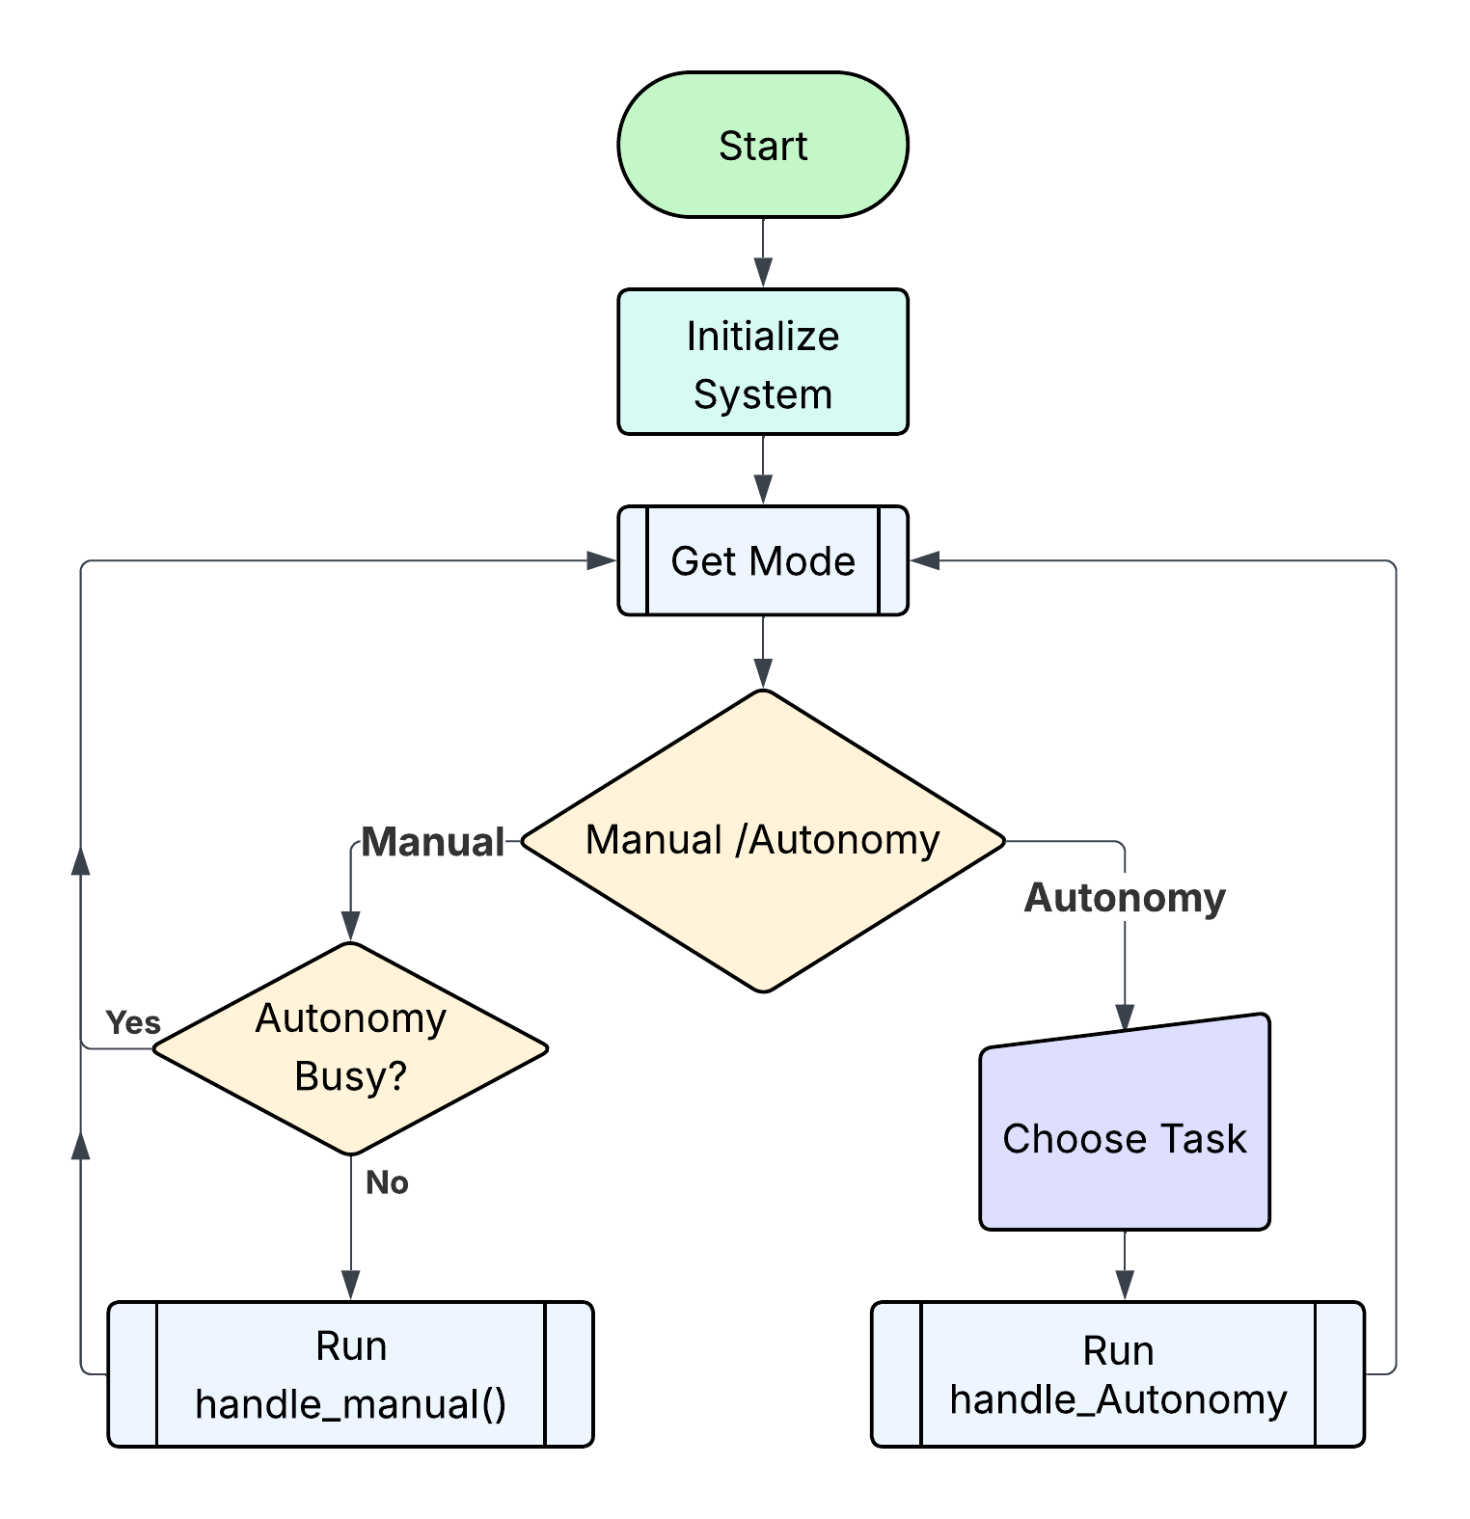
Main Flowchart

Slide 28
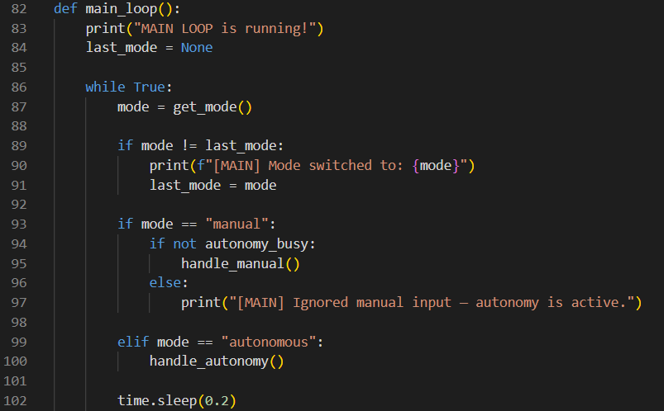
Contribution: Main loop
Continuously checks selected mode from the UI.
Detects when mode changes and prints the update.
If in manual mode, calls handle_manual() (unless autonomy is busy).
If in autonomous mode, runs handle_autonomy().
Ensures only one control path is active at a time.

Slide 29
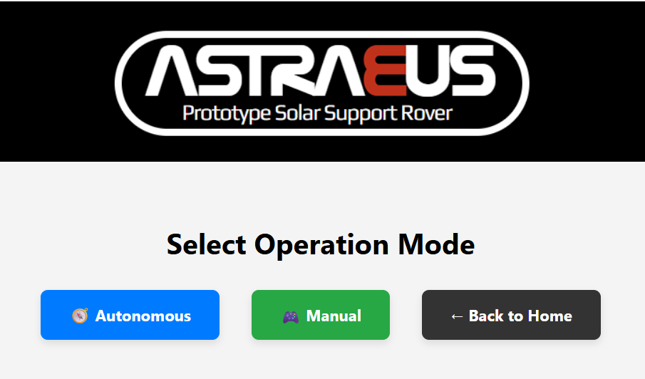
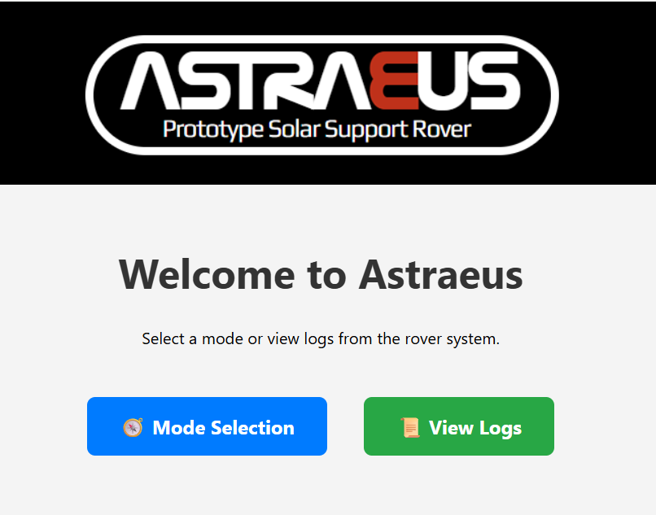
Contribution: Mode Select
Mode selection is handled through the Flask web interface (mode.html)
Two main modes are available:
  Autonomous
  Manual
Accessible from the home screen via the “Mode Selection” button.

Slide 30
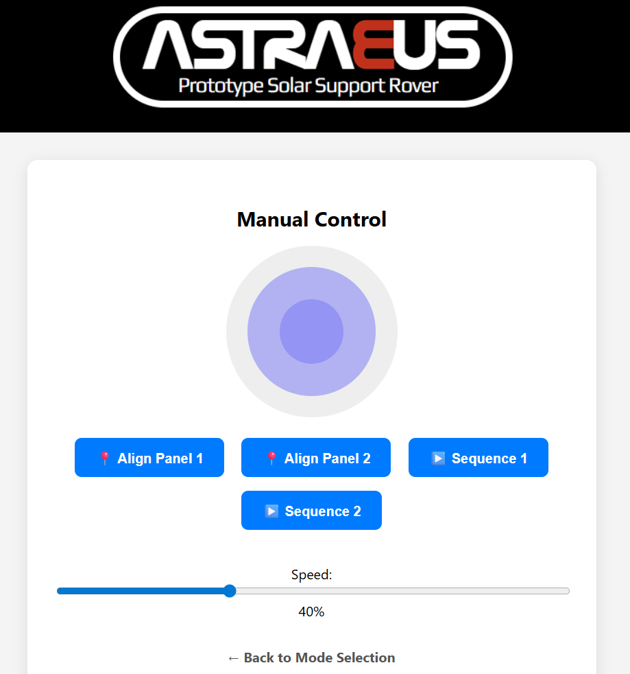
Contribution: Manual Interface
Controlled via joystick interface (manual.html, joystick.js)
User sends directional commands and cleaning triggers.
main.py parses joystick commands and speed.
Supports:
  Manual alignment with panel tags
  Triggering cleaning sequences 1 or 2 on demand.
Includes speed slider and real-time control.

Slide 31
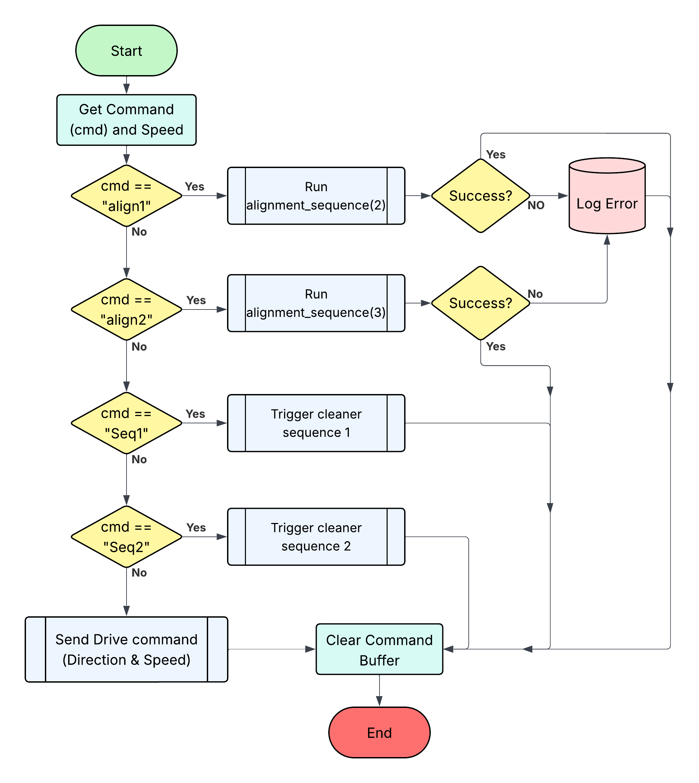
Manual Mode Flowchart

Slide 32
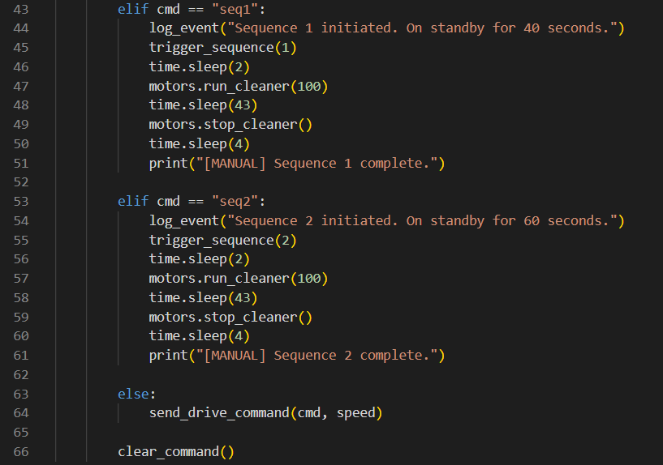
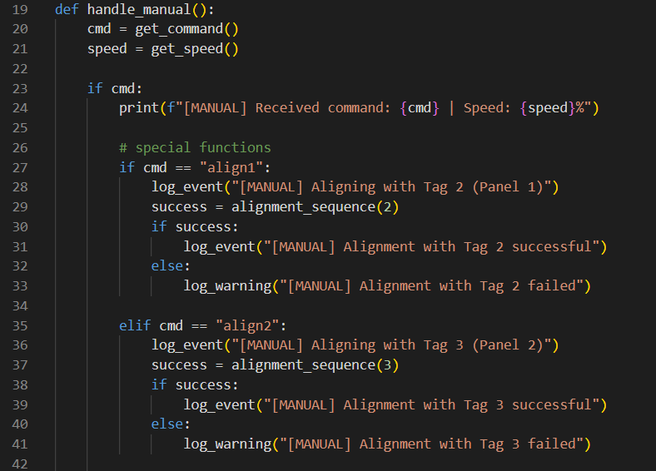
Manual Mode Code Logic
Triggers cleaning or alignment routines on demand.
Logs outcomes for visibility in the log dashboard.

Slide 33
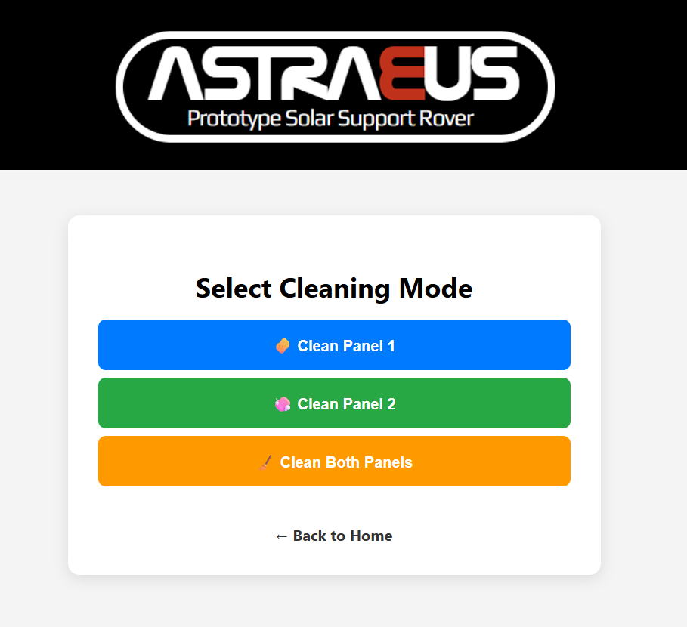
Contribution: Autonomous Mode
Activated via the Flask interface (autonomous.html)
User selects: Panel 1, Panel 2, or All Panels.
Calls autonomy.py, which:
  Locates AprilTags for panel positions.
  Aligns using tag coordinates and Sharp IR sensors.
  Triggers Maestro cleaning sequences.
Fully automated, no user input needed after start.

Slide 34
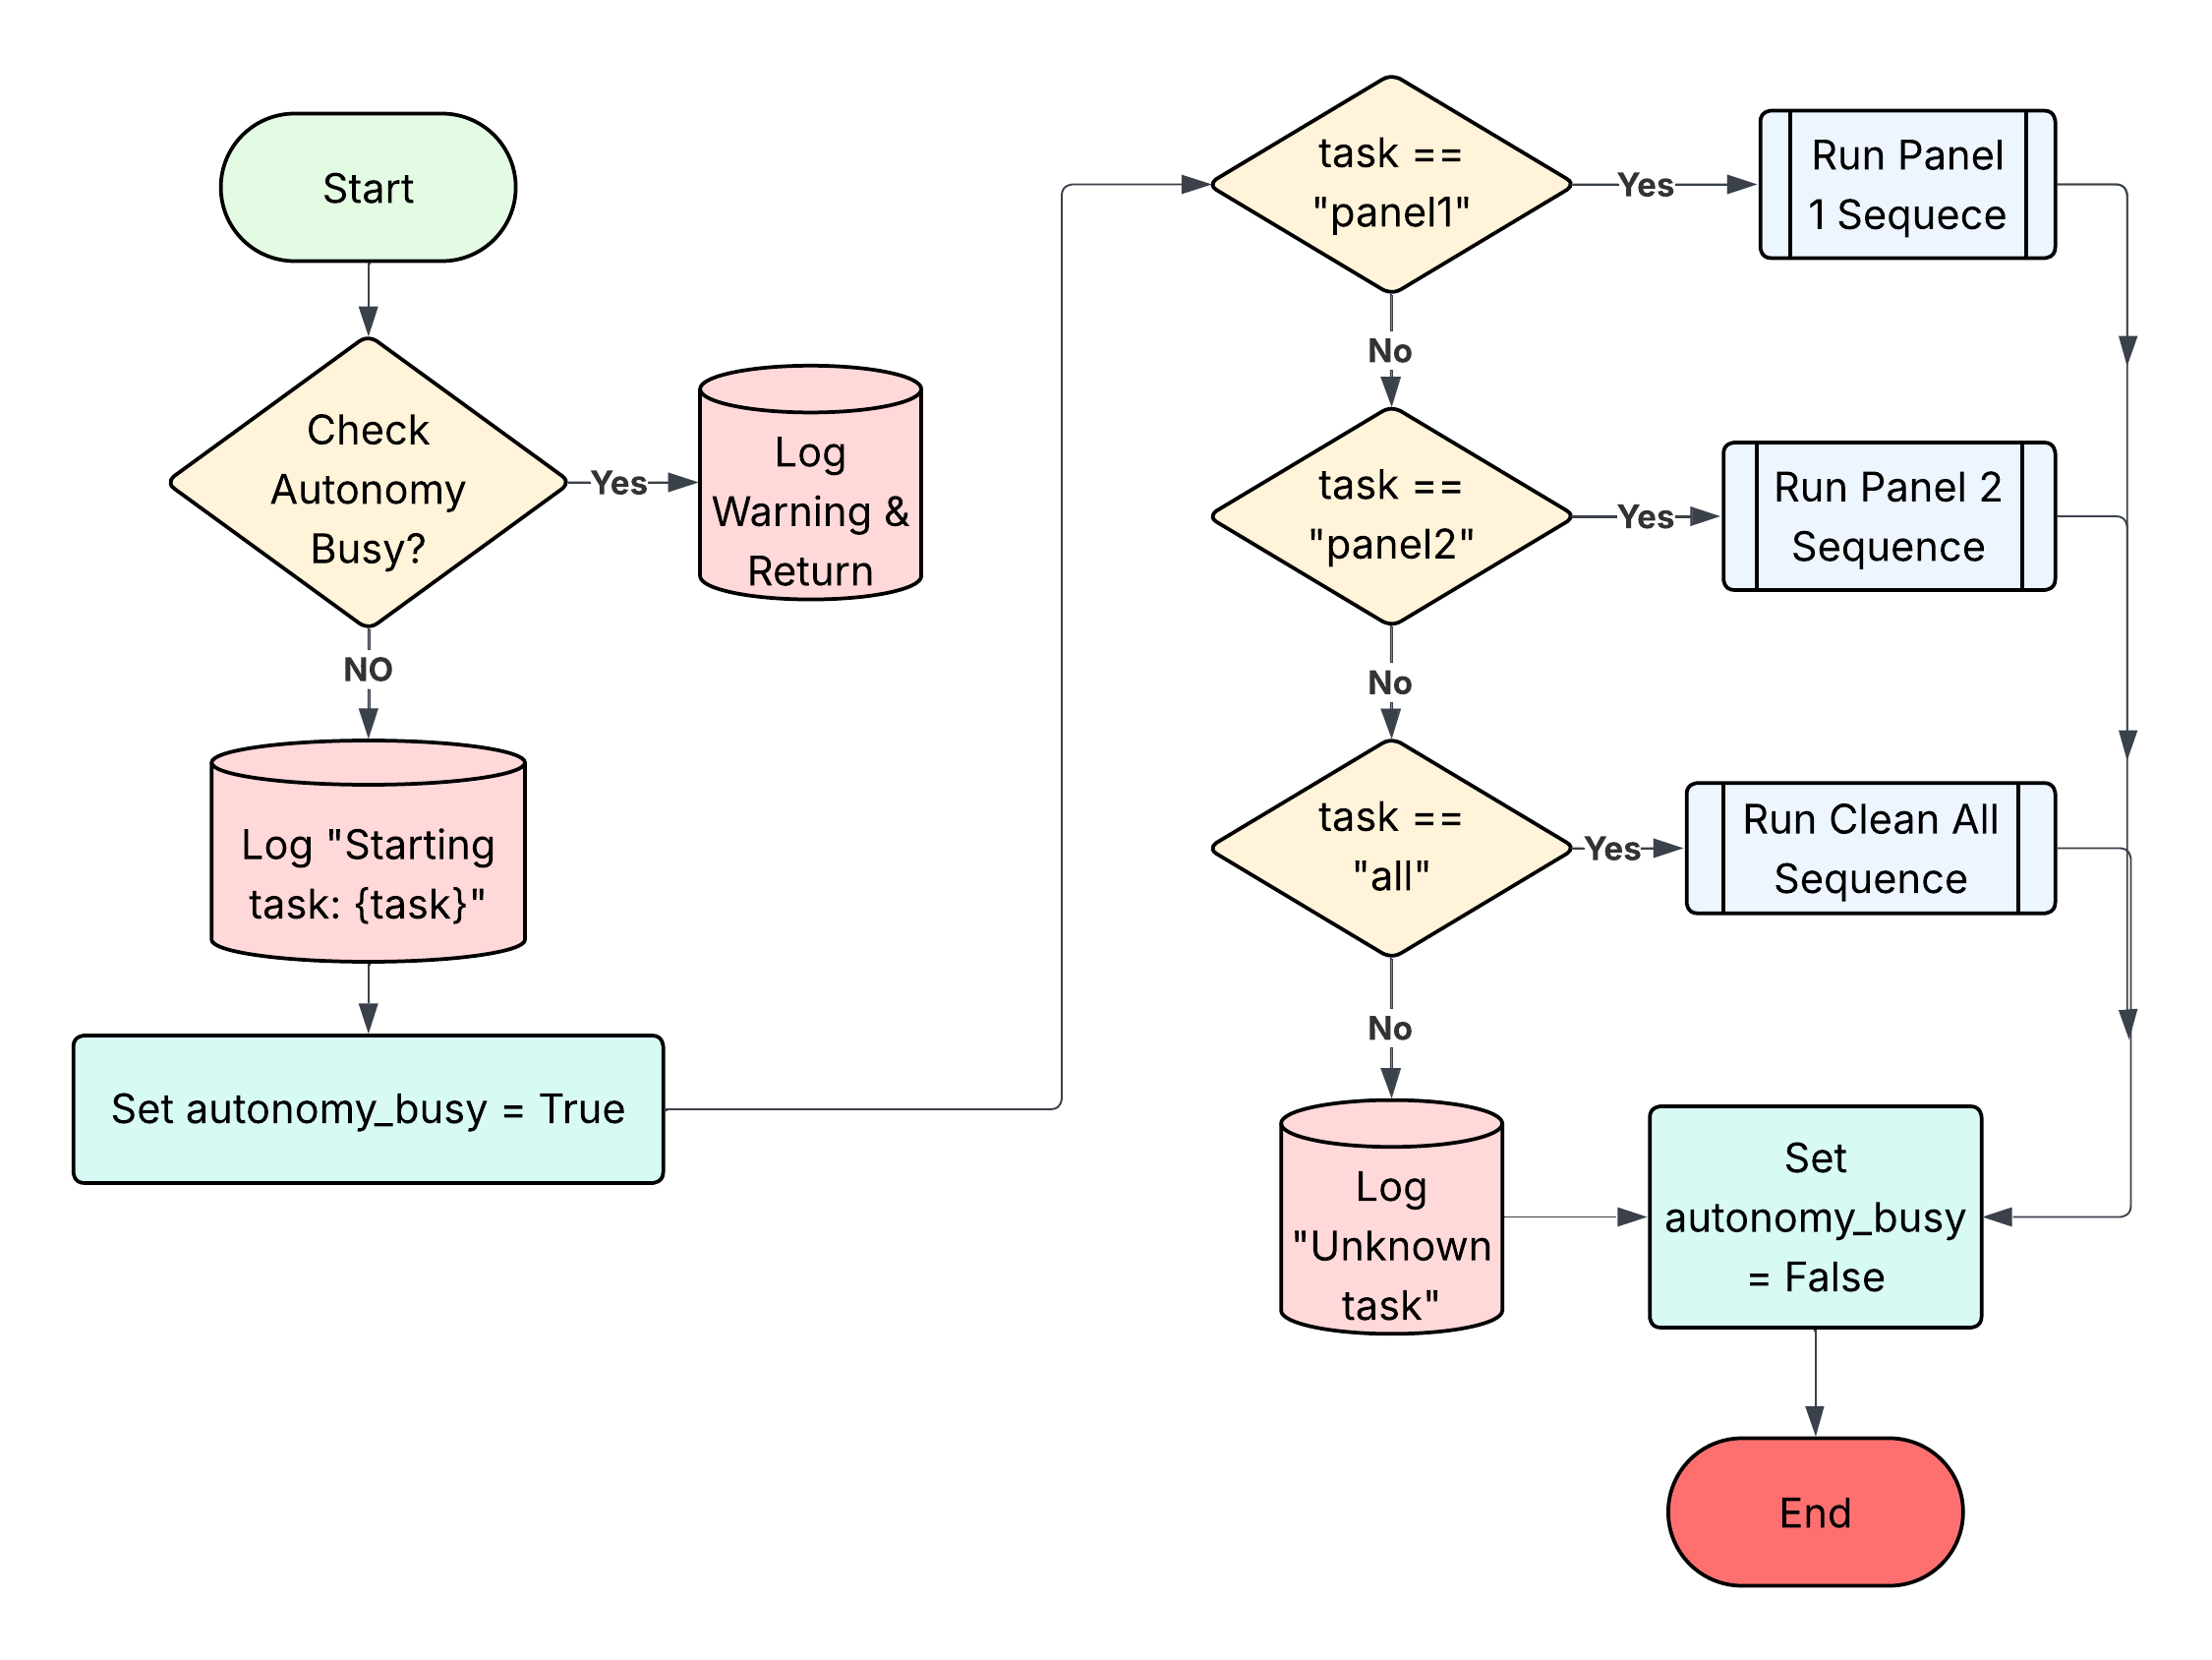
Autonomous Mode Flowchart

Slide 35
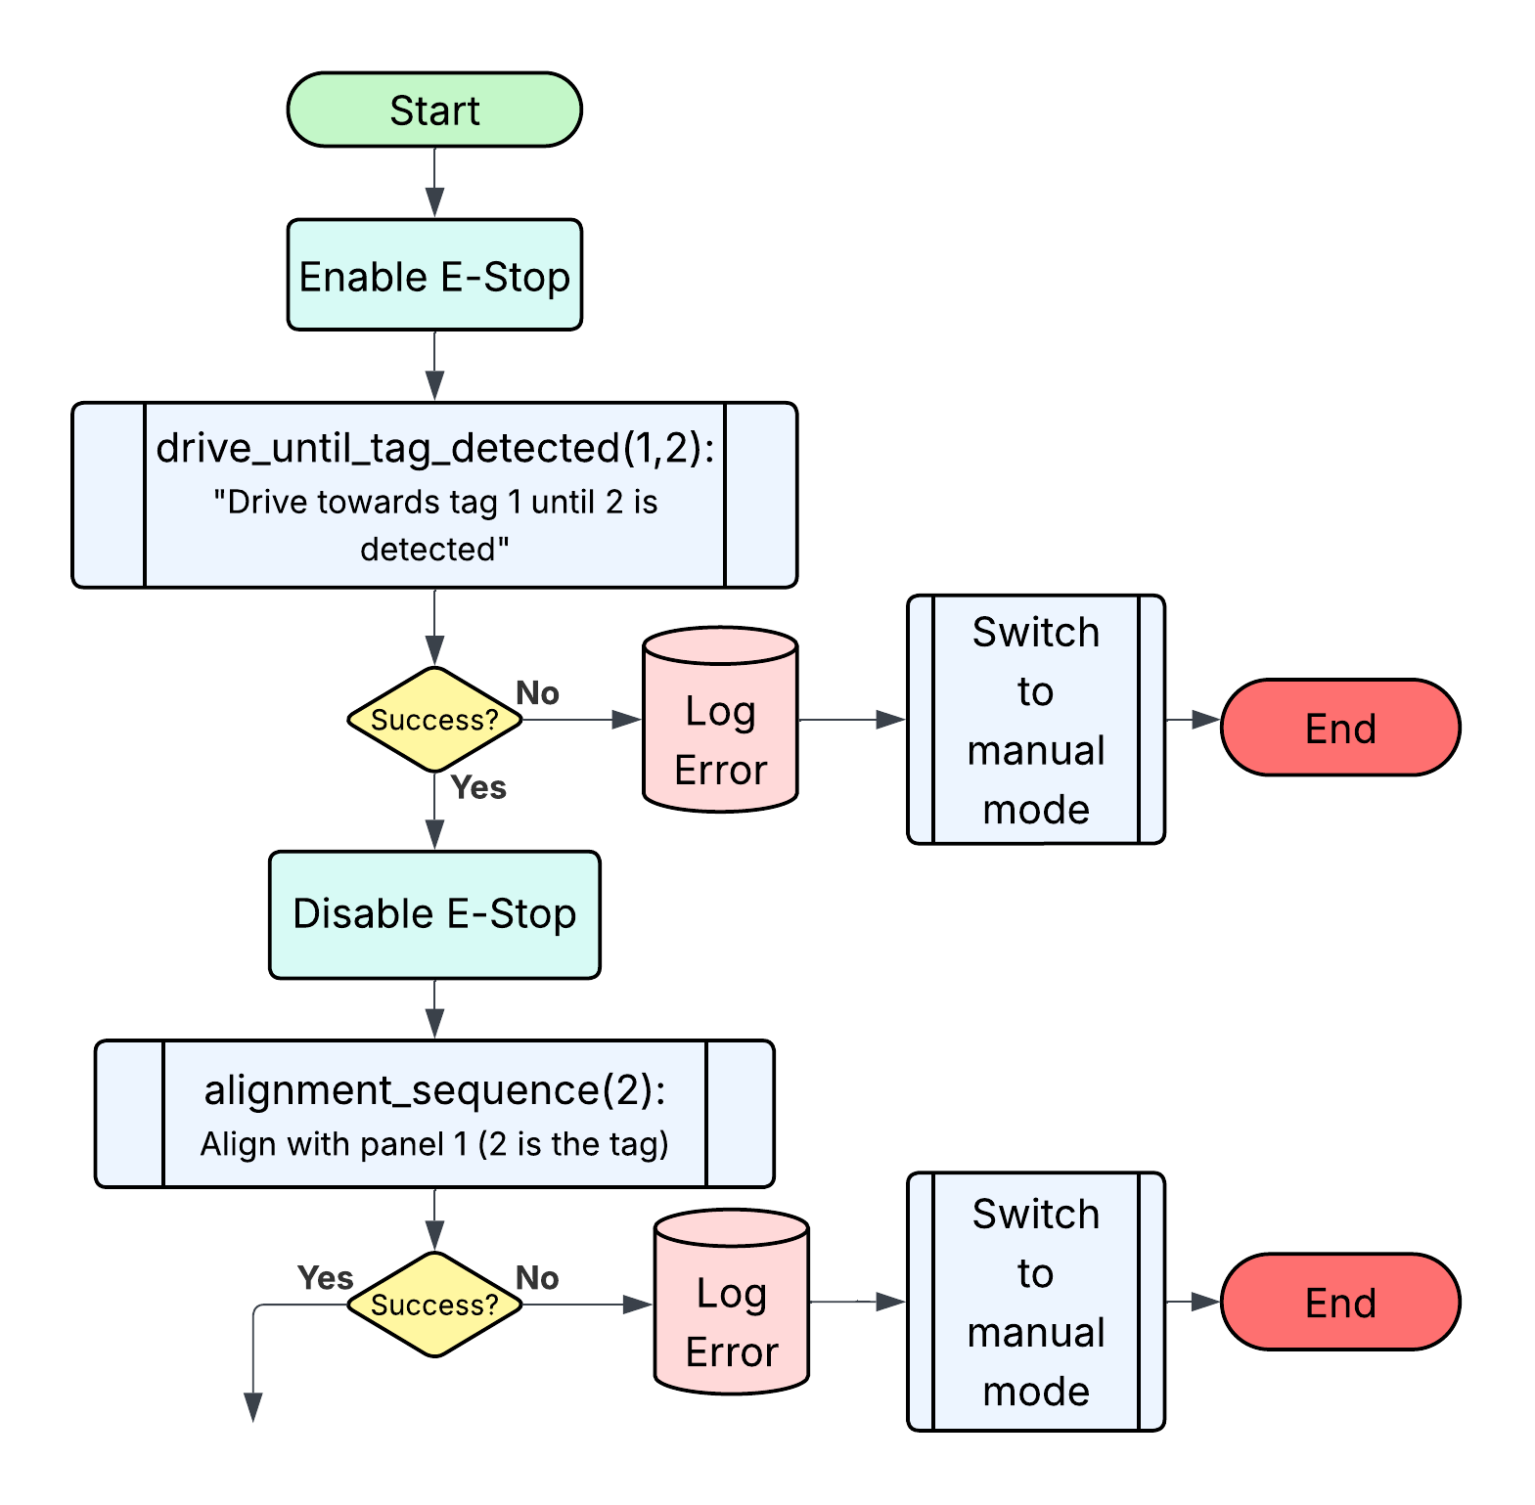
Clean All Flowchart
E-Stop when enabled Stops the rover if something is detected by the IR sensors.
Continues in next slide

Slide 36
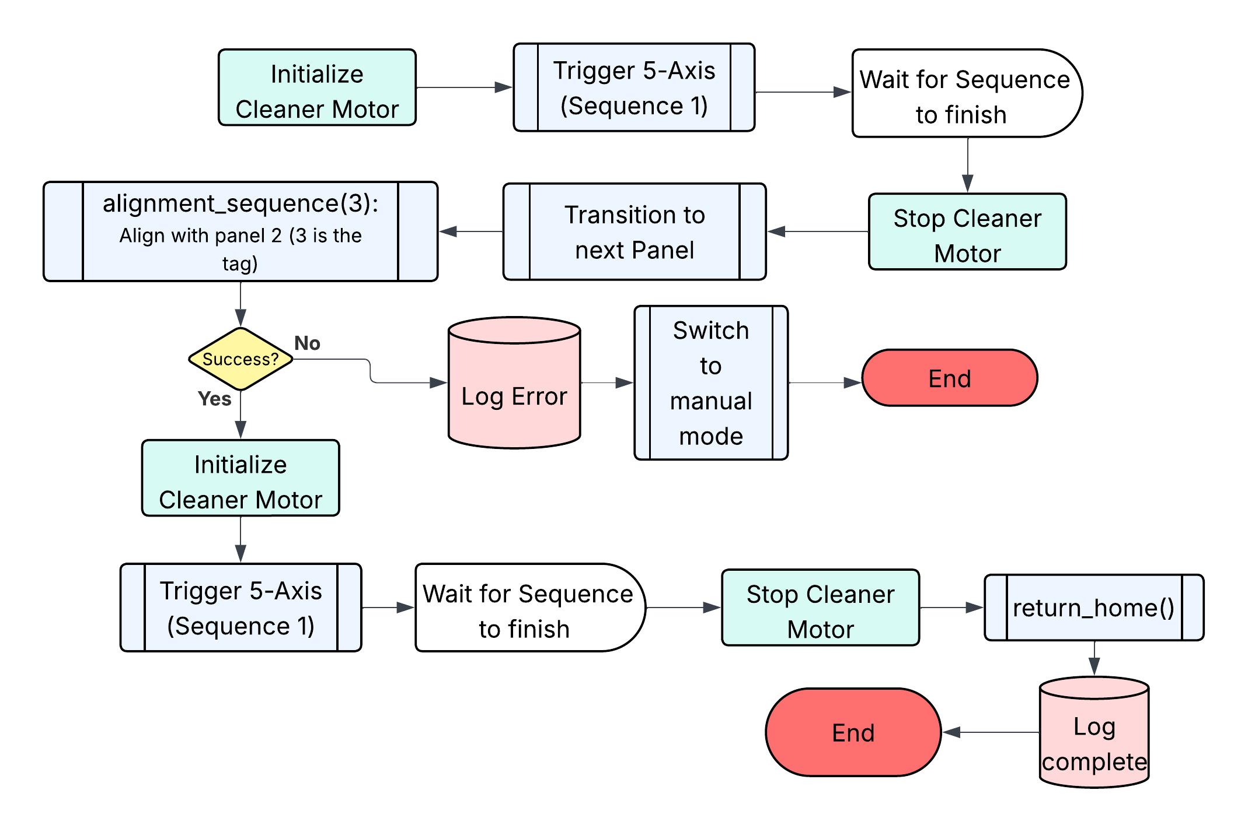
Autonomous Mode
Continues from previous
Inside of this process E-Stop is enabled and if fails sends to Manual Mode

Slide 37
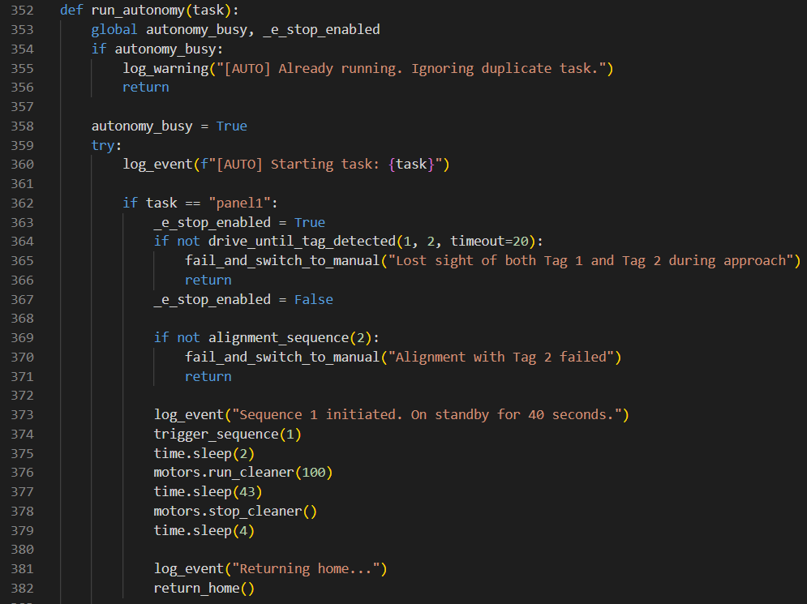
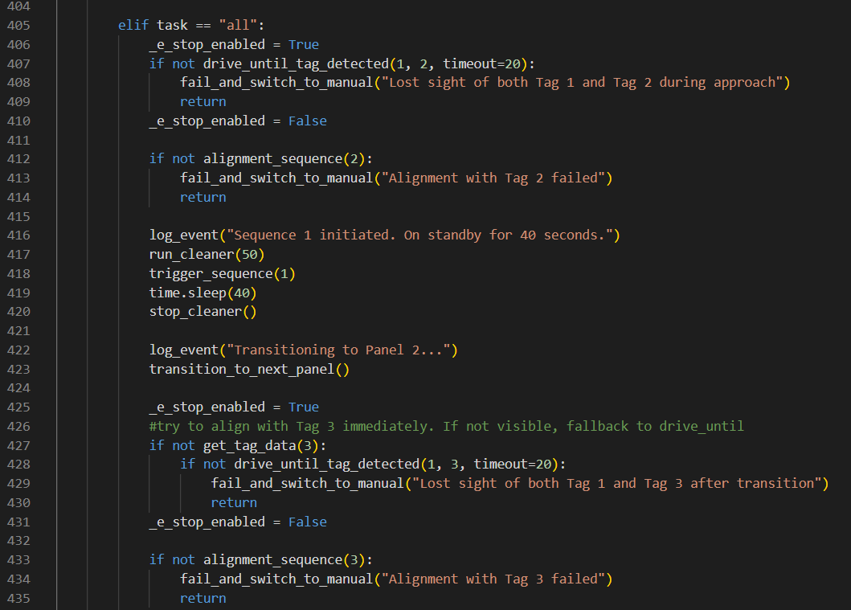
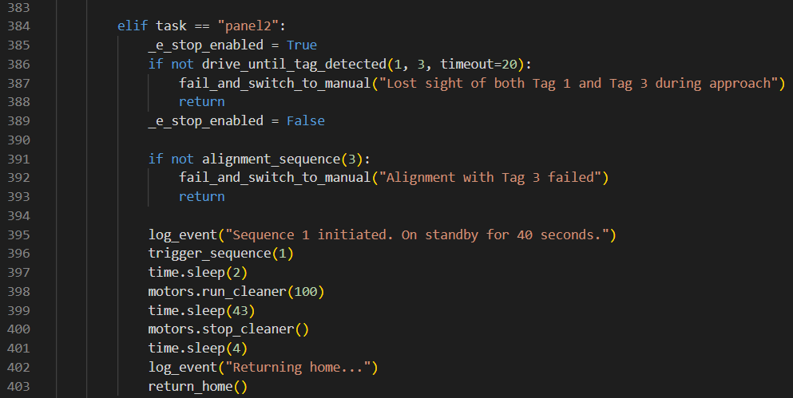
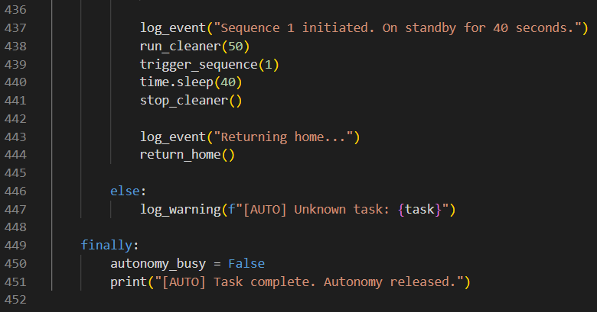
Contribution: Autonomous Logic
Run_autonomy():
Executes tasks: panel1, panel2, or all.
Follows AprilTags to locate and align with panels.
Runs a timed cleaning sequence after alignment.
Handles emergency stops and logs each stage.
Resets status flag to allow future tasks.

Slide 38
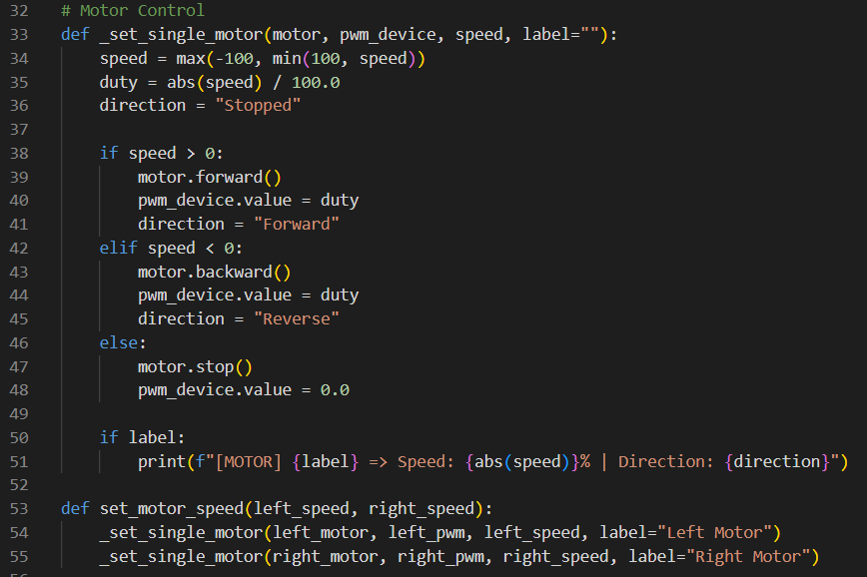
Contribution: Motor Control
_set_single_motor() sets speed and direction for one motor based on input.
Accepts speed from -100 to +100:
  Positive → Forward
  Negative → Reverse
  Zero → Stop
Uses PWM duty cycle to control motor power.
Automatically prints labeled output for debugging.
set_motor_speed() controls both left and right motors simultaneously.

Slide 39

Contribution: Logging System
Logs all events, warnings, and alerts to event_log.db using SQLite.
Supports three log levels: INFO, WARNING, and ALERT.
Each entry includes a timestamp, severity level, and message.
Used across all modules for status tracking and debugging.
Logs are later displayed in the web dashboard with color-coded severity.

Slide 40
Contribution: Visual Module
visual_module.py – AprilTag Detection via HuskyLens.
Tracks AprilTags and returns ID and position (x, y) relative to the camera.
Supports detection for all 4 AprilTags and more can be added.
sharp_sensor.py – Distance Sensing with Sharp IR Sensor.
Measures how close the rover is to a surface or panel.
E-stop function is declared within this module (emergency_stop_check()).
Both Modules use smoothing average algorithms to eliminate outlier readings.

Slide 41


5-Axis Cleaning arm High Level Requirement #1
“Utilize a variable speed cleaning brush with precise control over
speed and pressure to effectively clean surfaces.”
Astraeus meets the requirement by using PWM signals to control the speed of the brush while the brush pressure is controlled through the fifth servo axis, which tilts to adjust the contact angle with the panel. Utilizing the Maestro Control Center program to visual program the arm allowed fine-tuned control over both speed and pressure, ensuring the MGS-1 Was removed from the Panel without damaging the surface.
Video. Astraeus Cleaning Panel 2
* More videos are located on our website *

Slide 42

5-Axis Cleaning arm Medium Level Requirement #1
“ Document the cleaning of the solar panel by logging
the data for users to analyze the performance of the rover.”
Astraeus logs key events throughout the cleaning process, including when the rover aligns with the panel, initiates the cleaning cycle, and begins its return sequence. These entries are timestamped and stored by the Raspberry Pi in a structured log format.

Slide 43

Navigation High Level Requirement #1
“ Autonomously determine its own path to solar panels while
avoiding obstacles.”
Astraeus can navigate by identifying AprilTag 1 from a distance and autonomously moves toward it while continuously checking for obstacles using IR sensors. Once AprilTag 2 enters the field of view, the rover locks onto it for precise alignment with the solar panel. If an obstacle is detected during navigation, Astraeus slows down to a stop and logs the event, and switches to manual mode for safety during testing.
* More videos are located on our website *

Slide 44

Navigation High Level Requirement #2
“ Detect larger obstacles up to 40cm without running
into them without human intervention. ”
When an object is detected, Astraeus is able to slow down, come to a complete stop, and log the event as "Obstacle Detected!". For safety during testing, the system is designed to switch to manual control after detection persist for 20 seconds, allowing us to navigate around the obstacle.
* More videos are located on our website *

Slide 45

Navigation High Level Requirement #3
“Return to the starting position without any human intervention.”
After completing the cleaning cycle, Astraeus automatically backs up from the panel, performs a 180-degree turn, and scans the environment for a pre-defined AprilTag marking the starting position. Once detected, the rover navigates back autonomously without any human intervention.
* More videos are located on our website *

Slide 46
ASTRAEUS Bill of Materials
Line Item | Part # | Name | Qty | Price (USD) | Total | Supplier
1 | N/A | V Slot Aluminum Extrusion | 1 | $59.99 | $59.99 | Purchased/Provided by Valencia College
2 | N/A | OVERTURE PETG Filament 1.75mm | 8 | $15.99 | $127.92 | Purchased/Provided by Valencia College
3 | N/A | HuskyLens AI Camera | 1 | $59.90 | $59.90 | Purchased/Provided by Valencia College
4 | B0B825HRB9 | WWZMDiB Constant Current CC CV Buck Converter Module | 2 | $9.99 | $19.98 | Purchased/Provided by Valencia College
5 | 12V30Ah | 12V 30Ah Lithium LiFePO4 Battery | 1 | $62.99 | $62.99 | Purchased/Provided by Valencia College
6 | N/A | Greartisan DC 12V 10RPM Gear Motor | 6 | $14.99 | $89.94 | Purchased/Provided by Valencia College
7 | VNH5019 | Motor Driver Carrier | 3 | $29.95 | $89.85 | Purchased/Provided by Valencia College
8 | GP2Y0A21YK0F | Sharp IR Analog Distance Sensor (10-80cm) | 2 | $8.59 | $17.18 | Purchased/Provided by Valencia College
9 | N20-BT06 | 75:1 N20 Micro Gear Motor | 2 | $6.15 | $12.30 | Purchased/Provided by Valencia College
10 | ADS1115 | 16-bit 4 Channel I2C ADC PGA Converter | 1 | $15.99 | $15.99 | Purchased by Pedro
11 | N/A | 4 Channels I2C Logic Level Converter Bi-Directional 3.3V-5V Shifter | 1 | $7.49 | $7.49 | Purchased by Pedro
12 | 1352 | Mini Maestro 12-Channel Servo Controller | 1 | $32.95 | $32.95 | Purchased/Provided by Valencia College
13 | DS3225MG | 25kg Full Metal Gear RC Servo (2 pack) | 2 | $28.89 | $57.78 | Purchased/Provided by Valencia College
14 | DS3245SG | 45kg Full Metal Gear RC Servo | 2 | $31.99 | $63.98 | Purchased/Provided by Valencia College
15 | MG996R | 55g Metal Gear Servo (4 pack) | 1 | $16.68 | $16.68 | Purchased/Provided by Valencia College
16 | RPI3-MODB-1GB | Raspberry Pi 3 Model B | 1 | $49.79 | $49.79 | Purchased/Provided by Valencia College
18 | N/A | 4pcs 6mm Flange Coupling Connector | 4 | $8.99 | $35.96 | Purchased/Provided by Valencia College
19 | N/A | 1400 Pcs M4 Nuts Washers Kit | 2 | $21.99 | $43.98 | Purchased/Provided by Valencia College
20 | N/A | 100 Pieces 2020 Series M4 T Nuts | 1 | $5.99 | $5.99 | Purchased/Provided by Valencia College
21 | N/A | 600 Pcs M3 Screws Assortment Kit | 1 | $8.99 | $8.99 | Purchased/Provided by Valencia College
22 | N/A | Rod End Bearings 5mm FemaleThread | 1 | $8.99 | $8.99 | Purchased/Provided by Valencia College
23 | B0CDLKX842 | 14 AWG, 2-conductor CCA wire (Red & Black) 100 ft | 1 | $20.99 | $20.99 | Purchase by Mark
24 | B0BKGZRM8C | 18 AWG, 41‑strand, low-voltage wire 100 ft | 1 | $25.49 | $25.49 | Purchased by Mark
25 | Frienda-67892 | Frienda Servo Extension Cables | 2 | $8.99 | $17.98 | Purchased by Mark
26 | GUB-6-20 | GUBCUB Terminal Block Kit (6 Circuit, Duel-Row, 20A-30A, 200V-450V) | 4 | $10.49 | $41.96 | Purchased by Mark
27 |  | 282 Pieces Car Fuses Assortment Kit | 1 | $13.99 | $13.99
28 | N/A | M5 x 250mm Fully Threaded Rod 2Pcs | 1 | $5.49 | $5.49 | Purchased/Provided by Valencia College
Total (USD): |  |  |  |  | $1,014.52
Monetary Budget

Slide 47
Design Gantt Chart (Proposed)
Senior Design Tentative Timeline Summer 2025 May 5th - July 28th
Month | May |  |  |  | June |  |  |  | July
Week | Week 1 | Week 2 | Week 3 | Week 4 | Week 5 | Week 6 | Week 7 | Week 8 | Week 9 | Week 10 | Week 11 | Week 12
Task/Date | 05/05 | 5/12 | 5/19 | 5/26 | 06/02 | 6/9 | 6/16 | 6/23 | 6/30 | 07/07 | 7/14 | 7/21
Finish Assembling Astraeus
Program Obstacle Avoidance
Program AI Object Detection
Program Path to Solar Panel
Program Alignment Sequence
Program Return to Base
Create Database for logging
Field Testing and Debugging
Write Report
Create Presentation
Rehearse Presentation

Slide 48
Design Gantt Chart (Finalized)
Senior Design Timeline
Month | May |  |  |  | June |  |  |  | July
Week | Week 1 | Week 2 | Week 3 | Week 4 | Week 5 | Week 6 | Week 7 | Week 8 | Week 9 | Week 10 | Week 11 |  | Week 12
Task/Date | 05/06 | 5/13 | 5/20 | 5/27 | 06/03 | 6/10 | 6/17 | 6/24 | 7/1 | 07/08 | 7/15 | 7/18 | 7/22 | 7/25
Finish Assembling Astraeus |  |  |  |  |  |  |  |  |  |  |  | Report & Website Due |  | Presentation Date
Program Obstacle Avoidance
Program AI Object Detection
Program Path to Solar Panel
Program Alignment Sequence
Program Return to Base
Create Database for logging
Field Testing and Debugging
Write Report
Create Presentation
Rehearse Presentation

Slide 49

Health and Safety
Electrical components enclosed; insulated wiring & cable management.
Pinch points guarded with software limits & physical barriers.
IR sensors detect obstacles to avoid collisions.
Operates under 80 N to reduce injury risk (150 N hazard threshold).

Slide 50
Future Improvements
Solar Panel Efficiency Monitoring
Add onboard sensors to track solar panel voltage and current before and after cleaning. This would quantify the effectiveness of each cleaning cycle and validate performance gains in real time.
Autonomous Charging Station
Design a self-docking system to allow Astraeus to autonomously recharge between cleaning missions, increasing runtime and supporting long-term autonomous operation.
Stepper Motors for Robotic Arm
Replace high-current servos with precise stepper motors to improve positional accuracy and durability. The existing power budget supports this upgrade and would enable smoother motion and better torque control.

Slide 51


Summary & Conclusion
Proved viability of the concept as a scalable solution for solar maintenance on Mars using terrestrial-grade components
  Built and tested a modular rover using readily available materials and 3D-printed PETG parts
  Performed autonomous cleaning cycles with a 5-axis robotic arm and variable-speed brush system
  Use AprilTag detection and IR sensors to locate and align with solar panel
  Logged system activity including alignment, cleaning events, and return-to-base operations
  Validated subsystem performance through final testing in controlled regolith environment.
Visual comparison depicting potential cleaning effectiveness of Astraeus (Spring 2025)
Visual comparison depicting the cleaning effectiveness of Astraeus.

Slide 52
References
[1] Yvonne K. McKenna, “Humans to Mars,” NASA, Online. Available at: https://www.nasa.gov/humans-in-space/humans-to-mars.
​
[2] NASA, "Mars Exploration Rover (MER) - Opportunity," NASA Science, https://science.nasa.gov/mission/mer-opportunity/ (accessed Jul. 15, 2025).
[3] NASA, Multi-Mission Radioisotope Thermoelectric Generator (MMRTG), NASA Facts, NF-2020-05-619-HQ, May 2020. [Online]. Available: https://rps.nasa.gov
[4] SolarCleano, "Solar Panel Cleaning Robot – F1," SolarCleano, https://solarcleano.com/product/solar-panel-cleaning-robot-f1 (accessed Jul. 15, 2025).
[5] A. Verma, C. Yadav, B. Singh, A. Gupta, J. Mishra, and A. Saxena, “Design of Rocker-Bogie Mechanism,” Int. J. Innov. Sci. Res. Technol., vol. 2, no. 5, pp. 312–316, May 2017.
[6] B. D. Harrington and C. Voorhees, “The challenges of designing the rocker-bogie suspension for the Mars Exploration Rover,” in Proc. 37th Aerospace Mechanisms Symp., Johnson Space Center, Houston, TX, USA, May 2004, pp. 185–196.

Slide 53
References
[7] DFRobot, Metal DC Geared Motor - 12V 100RPM 42kg.cm, SKU: FIT0492-B, Apr. 2017. [Online]. Available: https://www.dfrobot.com/product-1472.html
[8] STMicroelectronics, VNH5019A-E: Automotive Fully Integrated H-Bridge Motor Driver Datasheet, Rev. 11, Jun. 2017. [Online]. Available: https://www.st.com
[9] Pololu, Micro Metal Gearmotor (N20) Series – Pololu 75:1 Gear Ratio, 12V Motor, Rev. 6.1, Pololu Corporation, 2023. [Online]. Available: https://www.pololu.com/file/0J1928/pololu-micro-metal-gearmotors-rev-6-1.pdf
[10] Pololu Corporation, Pololu Maestro Servo Controller User’s Guide, 2022. [Online]. Available: https://www.pololu.com/docs/0J40/all
[11] Solartech Power, “SPM030P-WP-F: 30 Watt Polycrystalline Solar Panel – Waterproof,” Solarflexion, [Online]. Available: https://www.solarflexion.com/v/vspfiles/files/pdfs/solartech-power/SPM030P-WP-F_Data_Sheet.pdf. [Accessed: July 15, 2025].
[12] SHARP Corporation, “GP2D120 Distance Measuring Sensor,” Sharp Datasheet, 2006.

Slide 54
References
[13] Texas Instruments, ADS111x Ultra-Small, Low-Power, I2C-Compatible, 860SPS, 16-Bit ADCs with Internal Reference, Oscillator, and Programmable Comparator Datasheet (Rev. E), Dec. 2024. [Online]. Available: https://www.ti.com/lit/pdf/SBAS444
[14] DFRobot, HuskyLens V1.0 AI Vision Sensor, SKU: SEN0305 / SEN0336. Accessed: Jul. 12, 2025. [Online]. Available: https://wiki.dfrobot.com/HUSKYLENS_V1.0_SKU_SEN0305_SEN0336
[15] RS Components, Raspberry Pi 3 Model B Product Sheet, RS Components, Accessed: Jul. 12, 2025. [Online]. Available: www.rs-components.com/raspberrypi
[16] Valencia College, “Waste & Recycling,” Sustainability at Valencia College, [Online]. Available: https://valenciacollege.edu/about/sustainability/waste-recycling.php. [Accessed: Jul. 12, 2025].
[17] Y. Shen, “Electronic product regulations in the United States: An overview,” Compliance Gate. [Online]. Available: https://www.compliancegate.com/electronic-product-regulations-united-states/.
[Accessed: Feb. 16, 2025].

Slide 55
References
[18] D. Mewes, “Safeguarding crushing points by limitations of forces,” PubMed, 2003. [Online]. Available: https://pubmed.ncbi.nlm.nih.gov/12820907/. [Accessed: Feb. 15, 2025].
[19] “Hand Injury Risk Assessment,” Occupational Safety and Health Administration (OSHA). [Online]. Available: https://www.osha.gov/hand-injury-prevention. [Accessed: Feb. 18, 2025].
[20] IEEE, “IEEE Code of Ethics,” IEEE.org, 2024. [Online]. Available: https://www.ieee.org/about/corporate/governance/p7-8.html. [Accessed: Jul. 12, 2025].

Slide 56
Thank You! ☺

